Slide 1
Surveying II
Surveying building interiors.
Property boundary changes.
Facade plan.
Dr. Lóránt Földváry
23 May, 2024

Slide 2
Surveying building interior
By surveying the buildings and deriving the results (site plan, cross-section), we check whether the building has been constructed according to the approved plans.
Therefore, the survey and the graphical representation must be carried out in the level of detail of the construction plans.

Slide 3
Surveying building interior: control network
A control network shall be installed on all floors of a multi-storey building, and adjacent floors should be connected.
The coordinate system should be oriented parallel to the main walls.
Vertical reference points shall also be established, and adjacent floors shall be connected by at least two independent transferring of the height system.

Slide 4
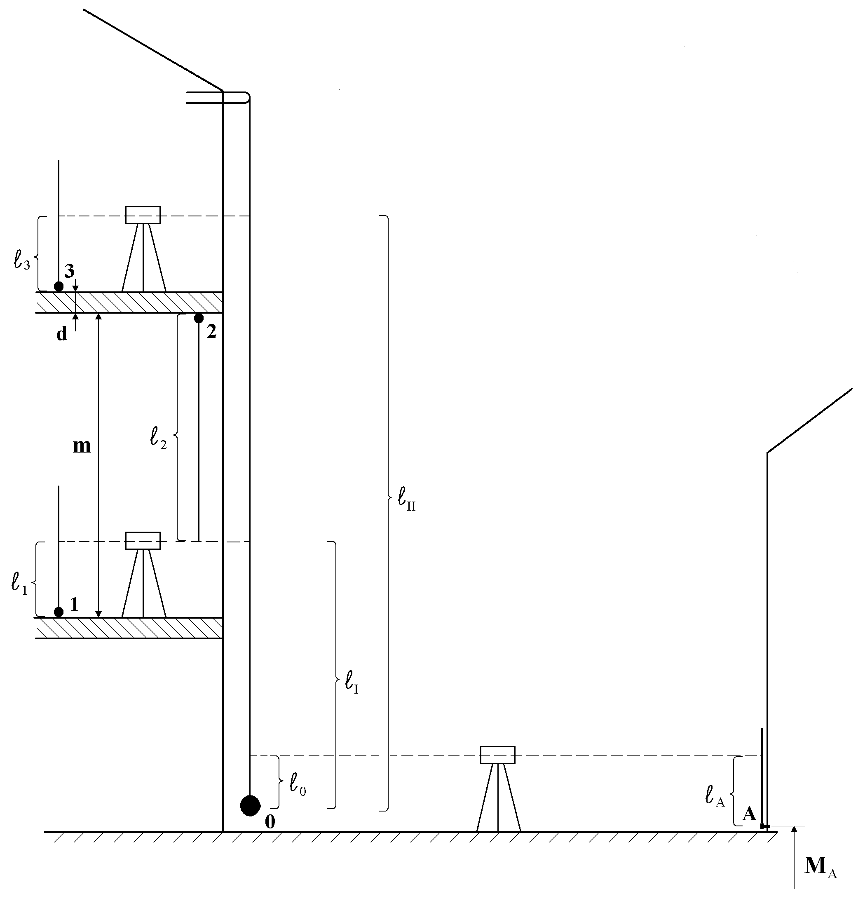

Slide 5
Surveying building interior: Detailed survey
For recording the measurements, a copy of the construction plan can be used as a sketch for writing down the measurements and notes.
It is essential to be able to carry out the detail surveying from the network points in a simple yet comprehensive manner.
It is better to measure continuous dimensions rather than measuring in parts. Even though the calculation is more laborious (basically, subtractions), the measurement is more favourable from error propagation aspects.

Slide 6
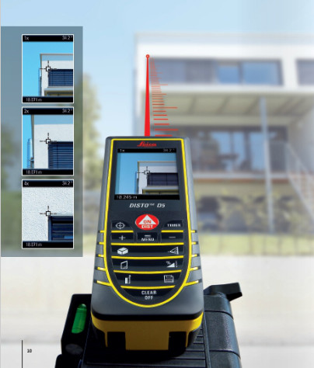
Surveying building interior: Detail surveying
Detail surveying of building interior basically applies distance measurements, which can efficiently be done with handheld distance meters.
Such an instrument has a range of 80-100 m and an accuracy of 2-3 mm. It has the advantage of being able to measure distances to difficult-to-reach points, for example, to measure to the ceiling of the room.

Slide 7
Surveying building interior: Detailed survey
If the wall thickness cannot be measured directly, we have to indicate that the wall thickness is a derived value.
For determining sections, relevant height parameters (e.g. height of ceilings, window-sills, fenestrations) should also be measured.

Slide 8
Surveying plan, site plan

Slide 9
Surveying plan, site plan
should be drawn to a scale of 1:100 or 1:50.

Slide 10
Surveying plan, site plan
should be drawn to a scale of 1:100 or 1:50.
It should contain:
walls, door frames and window cases,
sizes (in both dimensions) of rooms, their function, floor area and floor covering material,
built-in (fix) equipments,
the width, height and position of internal and frontal doors and windows,
the height above floor level of the window stool,
the height of the floor level (in local height system),
the ceiling height of the rooms, etc.

Slide 11
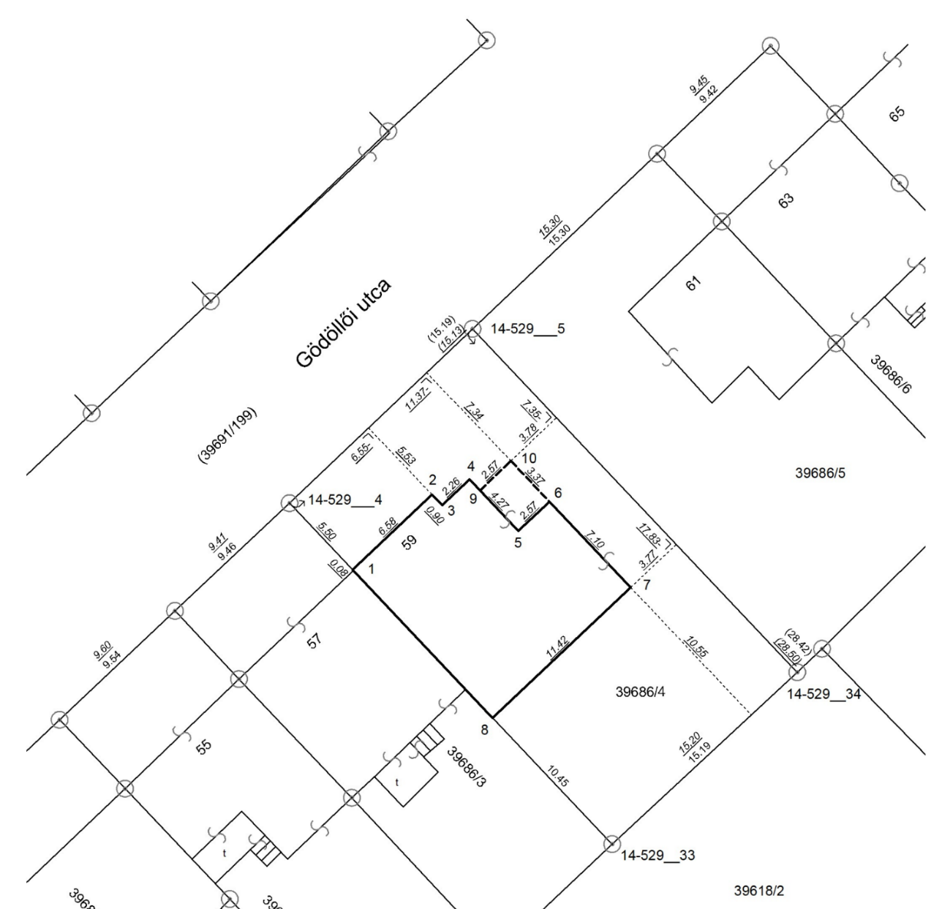
Property boundary map

Slide 12
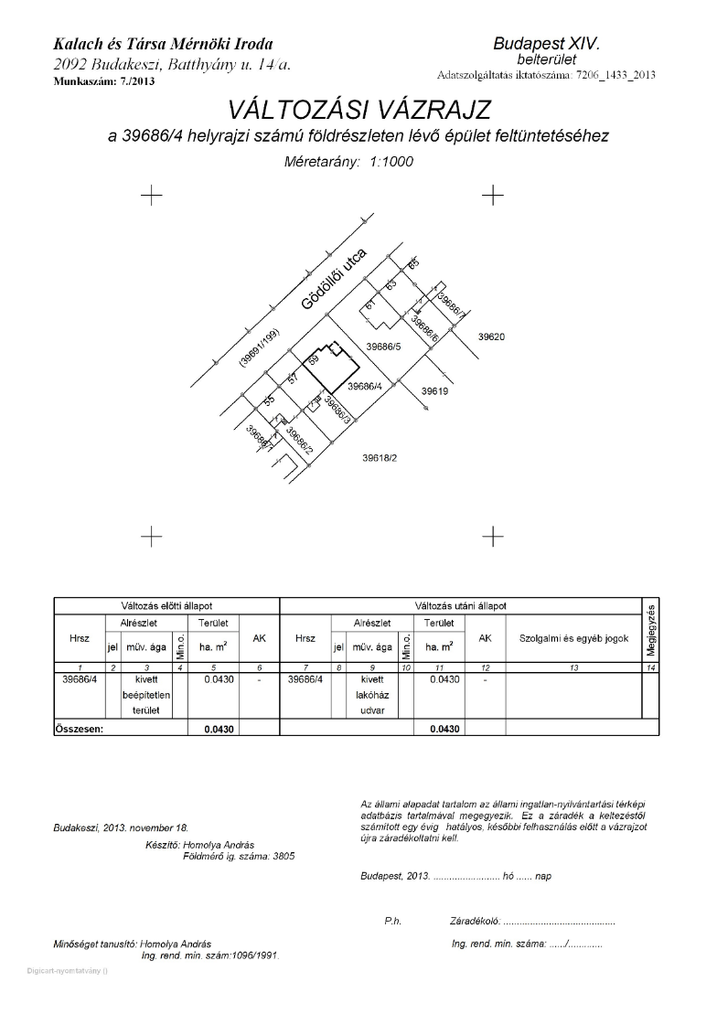
Property boundary changes (lot split)

Slide 15
Facade plan
In order to preserve (archive) the townscape, a facade drawing of the building should be made.
Geodetic methods (e.g. 3D intersection) can be used to survey flat and simple facades.
Close-range photogrammetry can be used for complex facades.

Slide 16
Surveying plan, western facade

Slide 17
Surveying plan, eastern facade

Slide 18
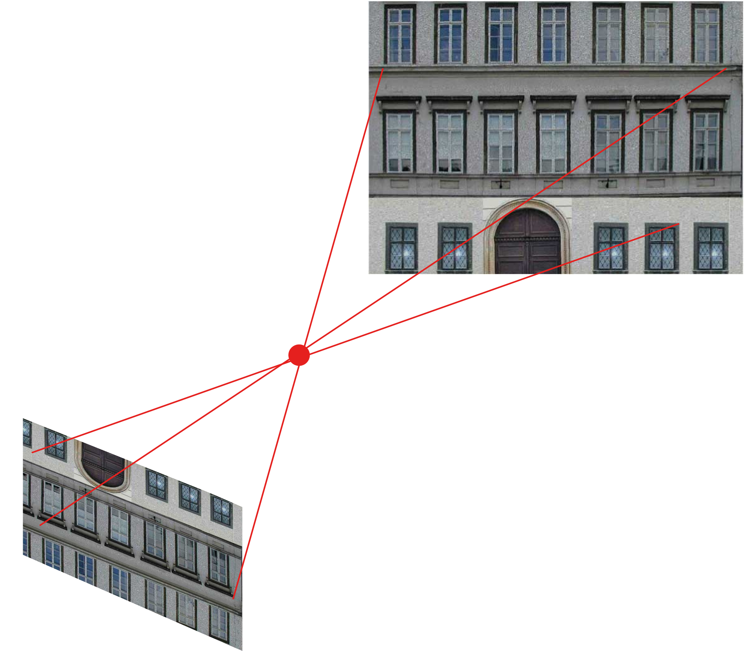
(Terrestrial) Close-range photogrammetry
Monumental buildings usually have very complex facades. For the survey of such buildings, the terrestrial photogrammetry method is recommended.
A photogrammetric survey of the building is carried out using cameras (traditionally mounted on a measuring stand, and set up at a known point relative to the building).

Slide 19
(Terrestrial) Close-range photogrammetry
As a result of processing the photographs, geodetic coordinates of the points of interest (points of the building) can be determined
from the measurements made on the photographs (in pixel coordinates),
and the geometry describing the mutual position of the image and the building.

Slide 20
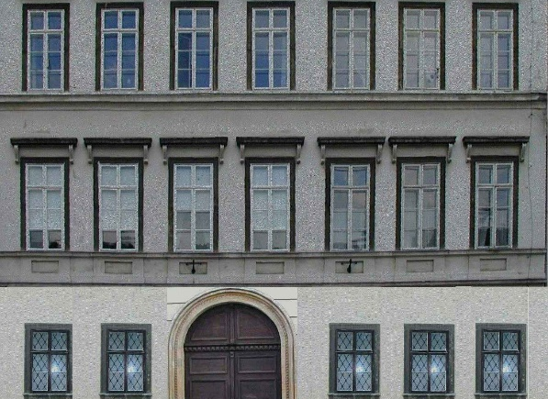
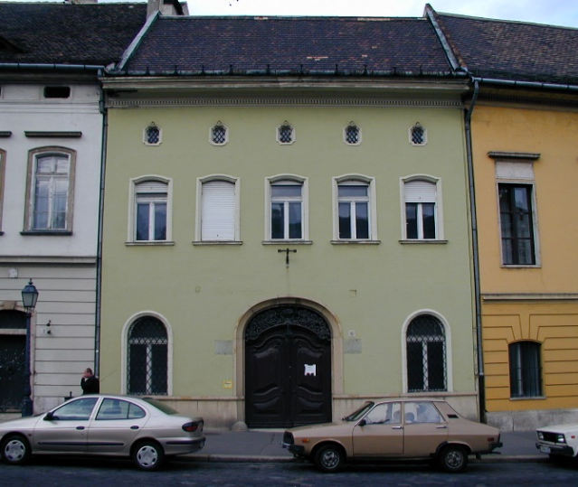
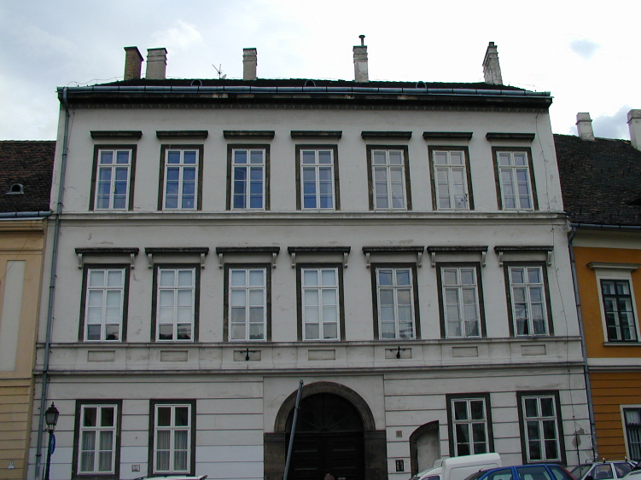
Facades of some buldings in the Buda Castle – original vs. transformed

Slide 21
The model created by processing geodetic and photogrammetric measurements

Slide 22
A modell of the city centre of Óbuda

Slide 23
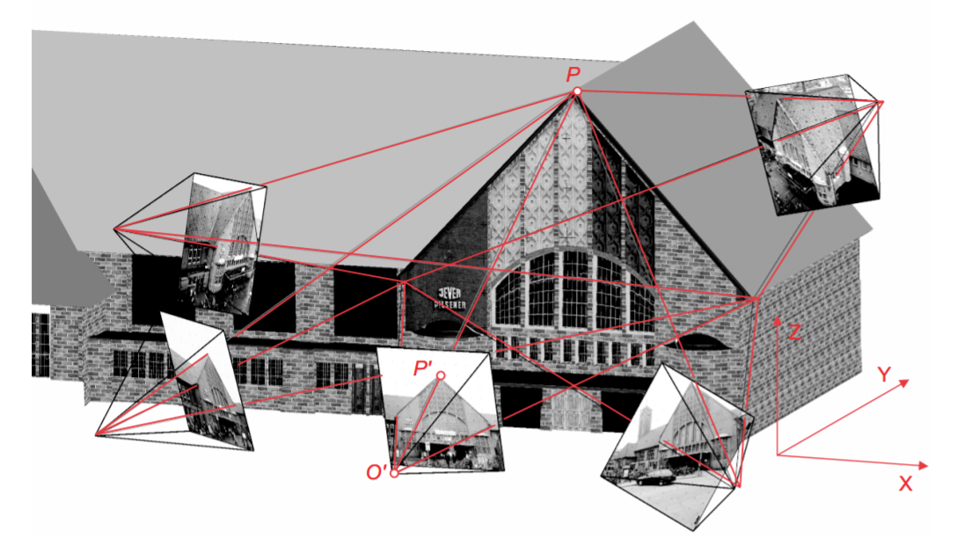
Close-range photgrammetry

Slide 24
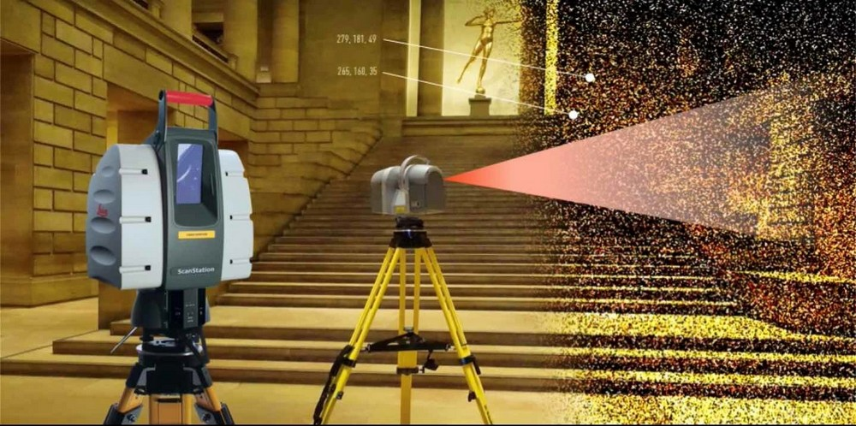
Laser scanning

Slide 25
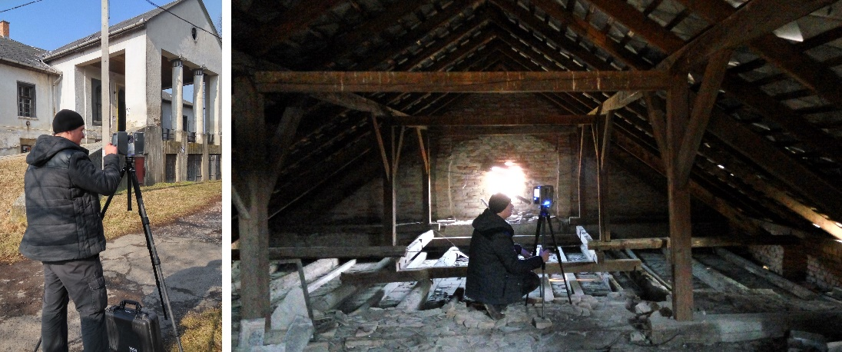
Laser scanning

Slide 26
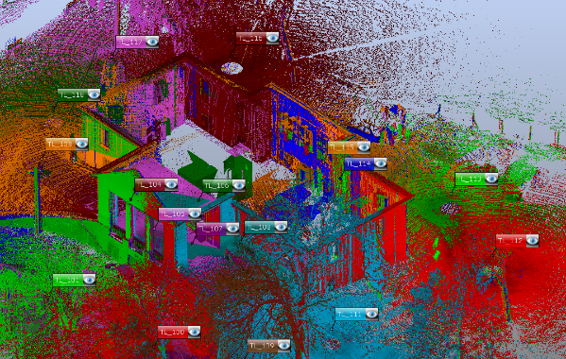
Laser scanning

Slide 27
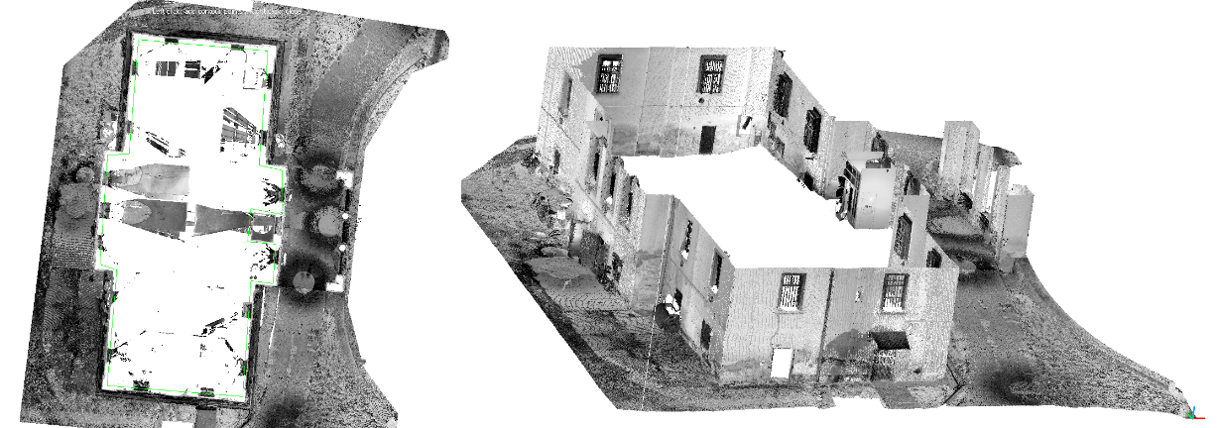
Laser scanning

Slide 28
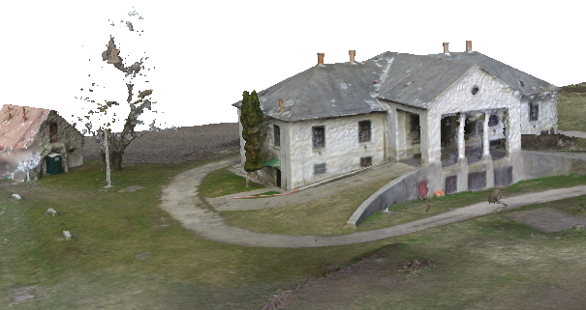
Laser scanning

Slide 29
Laser scanning

Slide 30
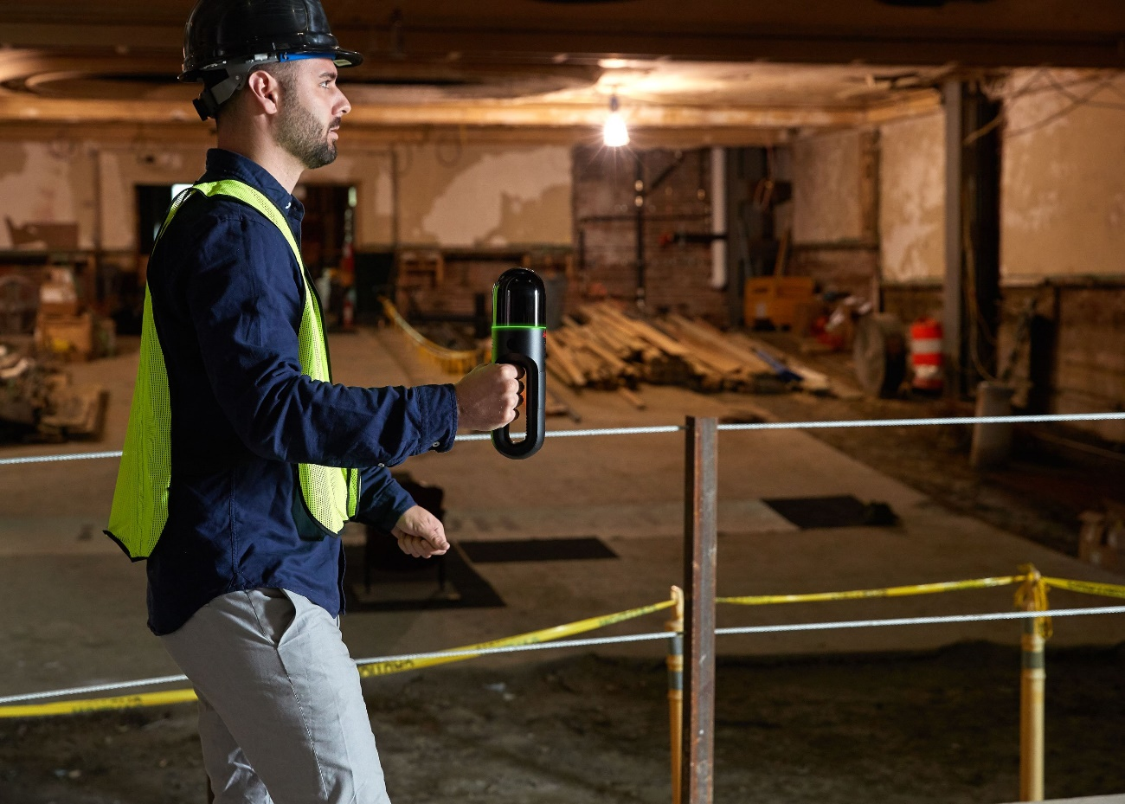
Mobile mapping systems
SLAM: Simultaneous Localization And Mapping
Laser scanner
IMU (Inertial Navigation Unit):
accelerometer,
magnetometer,
gyroscope
SLAM: joint fitting point cloud and IMU data

Slide 31
Thank you for the attention!

