Slide 1
Surveying I.
Positioning. Elevation, height, height measurements. The principle of optical levelling. The structure of the surveyors’ level.
Created by Dr. Szabolcs RÓZSA
Lecturer: Dr. Lóránt FÖLDVÁRY
September 9, 2024

Slide 2
Surveying vs Geodesy
Geodesy: the determination of the shape and the size of the Earth and its gravity field. To provide the fundamentals of positioning (control networks, etc.)

Slide 3
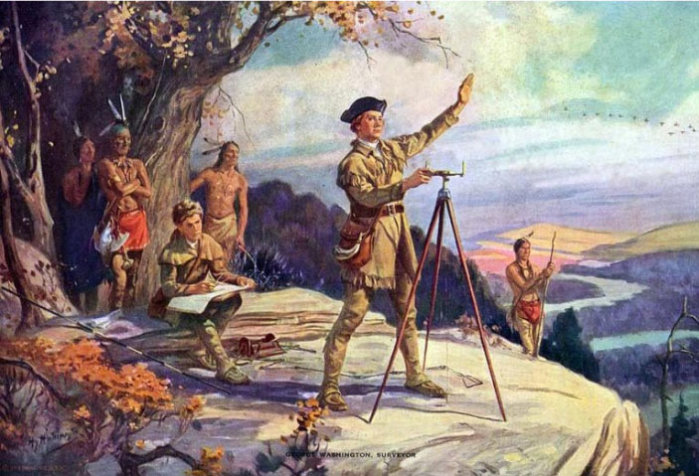
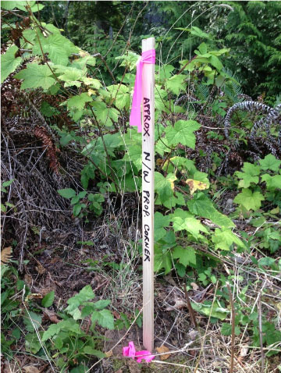
Surveying vs Geodesy
Surveying: the determination of the location and the shape of natural or man-made objects on the ground (or above/below) (survey), and present the results numerically or graphically (mapping) and the localization of the characteristic points of planned structures on the field (stake out/set out).

Slide 4
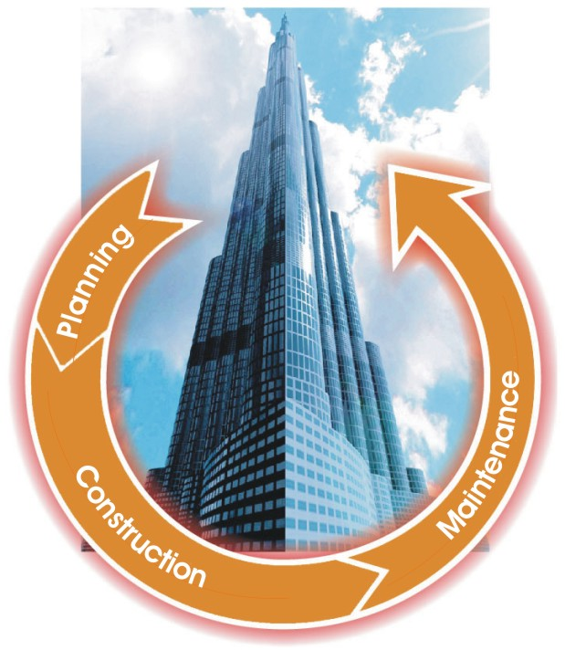
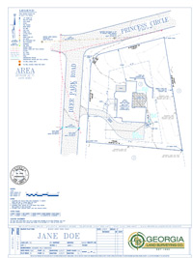
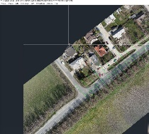
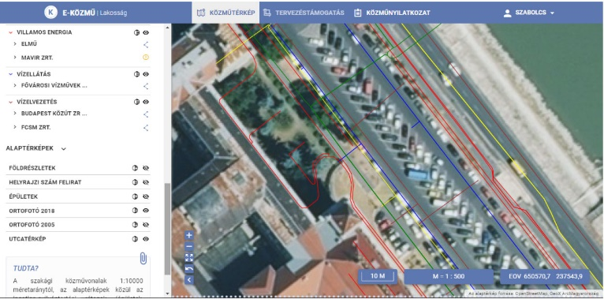
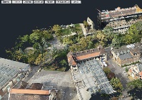
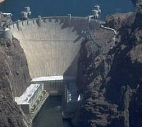
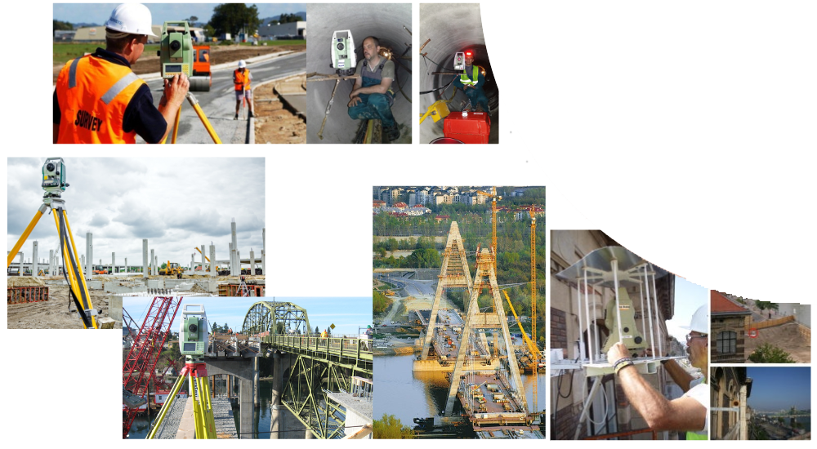
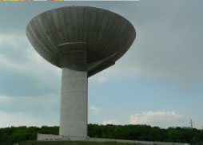

Slide 5
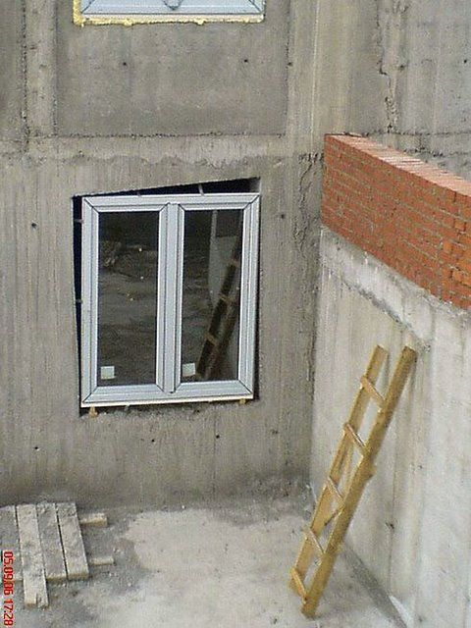
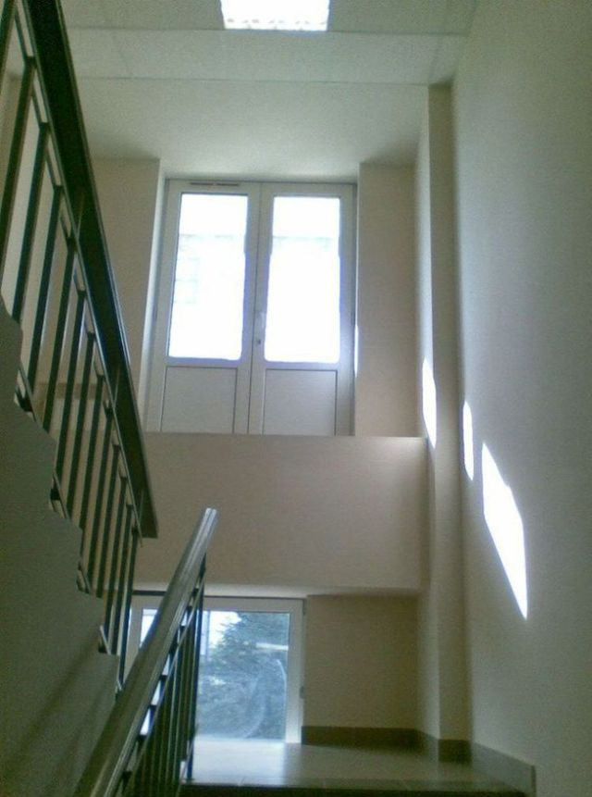
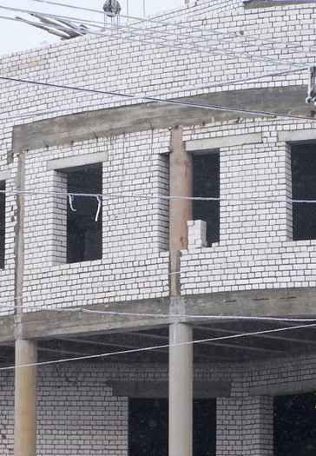
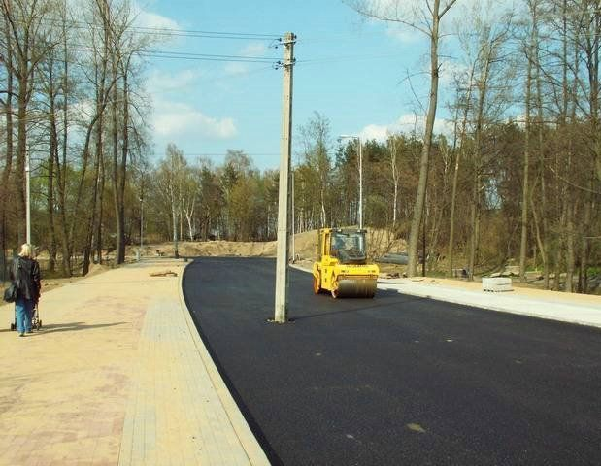
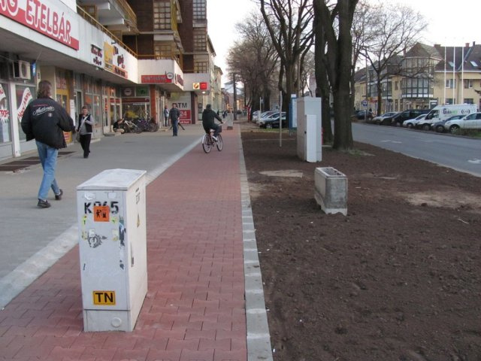
What can happen, when no surveyors are available on site?

Slide 6
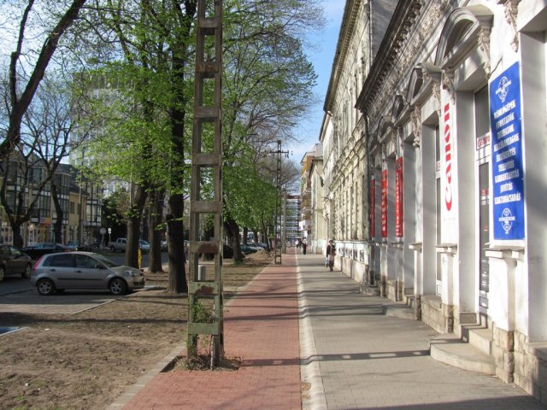
What can happen, when no surveyors are available on site?

Slide 7
What will this course provide you?
You’ll start thinking as a civil engineer.
Knowledge on Land Surveying:
You’ll be able to carry out smaller surveying works.
You’ll be able to communicate your goals with the surveyor and you’ll understand his answers.

Slide 8
Assessments
MT1 max. 20 points (min. 10 is required)
MT2 max. 20 points (min. 10 is required)
PT passed/failed (requirement: pass)
-------------------------------------
Sum: max. 40 points (min. requirement is 20)
Exam: max. 60 points (min. requirement is 30)
Final grade:
failed (1) 0 - 49 points
pass (2) 50 - 62 points
satisfactory (3) 63 - 75 points
good (4) 76 - 87 points
excellent (5) 88 - 100 points

Slide 9
Textbooks, notes
1. Bannister-Raymond-Baker: Surveying
2. Draft notes of the Lectures + slides
http://edu.epito.bme.hu
3. Electronic handouts for the practicals
http://edu.epito.bme.hu
4. Last, but not least: YOUR OWN NOTES TAKEN ON THE CLASSES!

Slide 10
Surveying I.
Positioning. Elevation, height, height measurements. The principle of optical levelling. The structure of the surveyors’ level.
Created by Dr. Szabolcs RÓZSA
Lecturer: Dr. Lóránt FÖLDVÁRY
September 9, 2024

Slide 11
Surveying vs Geodesy
Geodesy: the determination of the shape and the size of the Earth and its gravity field. To provide the fundamentals of positioning (control networks, etc.)
Surveying: the determination of the location and the shape of natural or man-made objects on the ground (or above/below) (survey), and present the resutls numerically or graphically (mapping) and the localization of the characteristic points of planned structures on the field (stake out/set out).

Slide 12
Geodesy
What is the shape of the Earth?

Slide 13
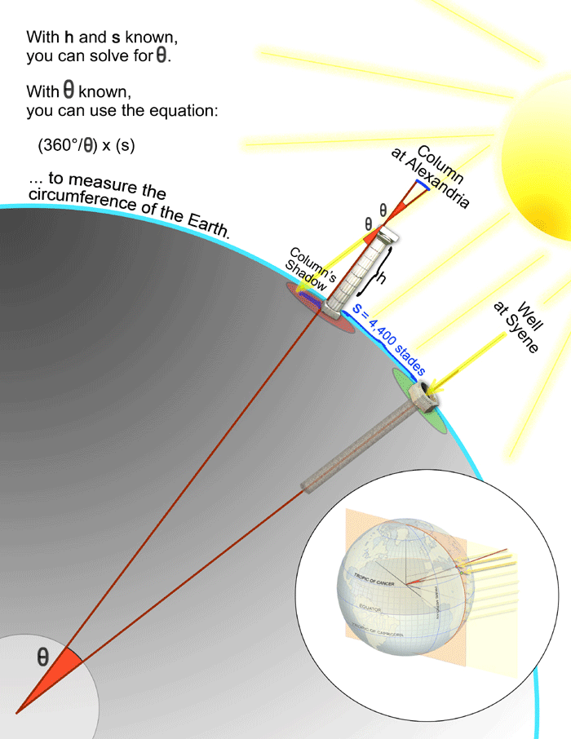
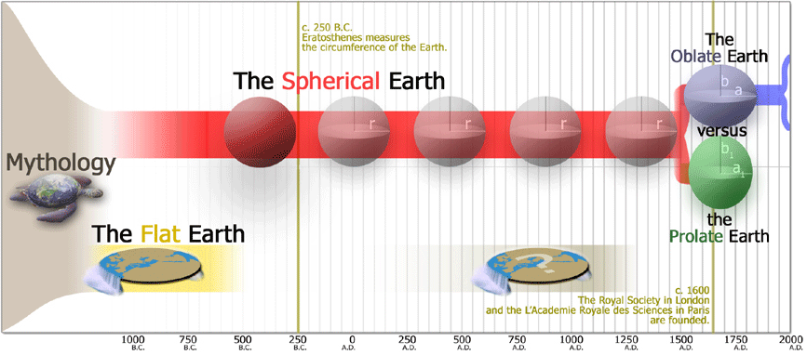
Geodesy
1735

Slide 14
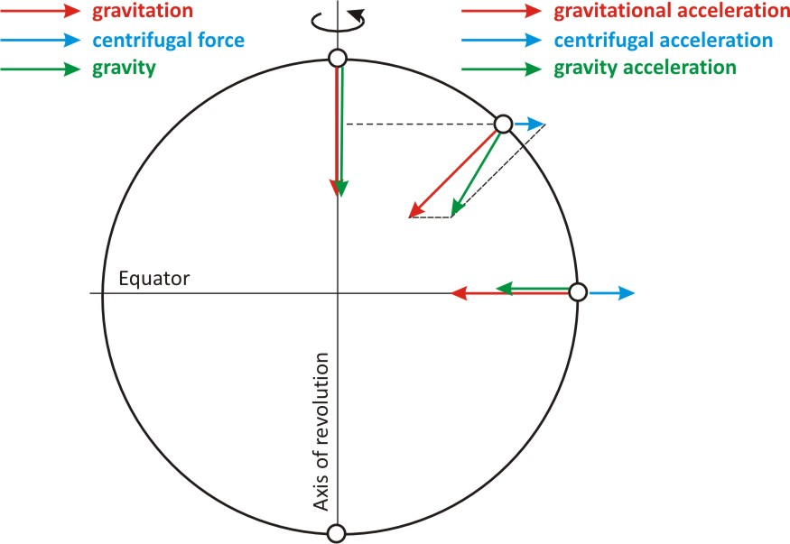
Geodesy
The gravity field

Slide 15
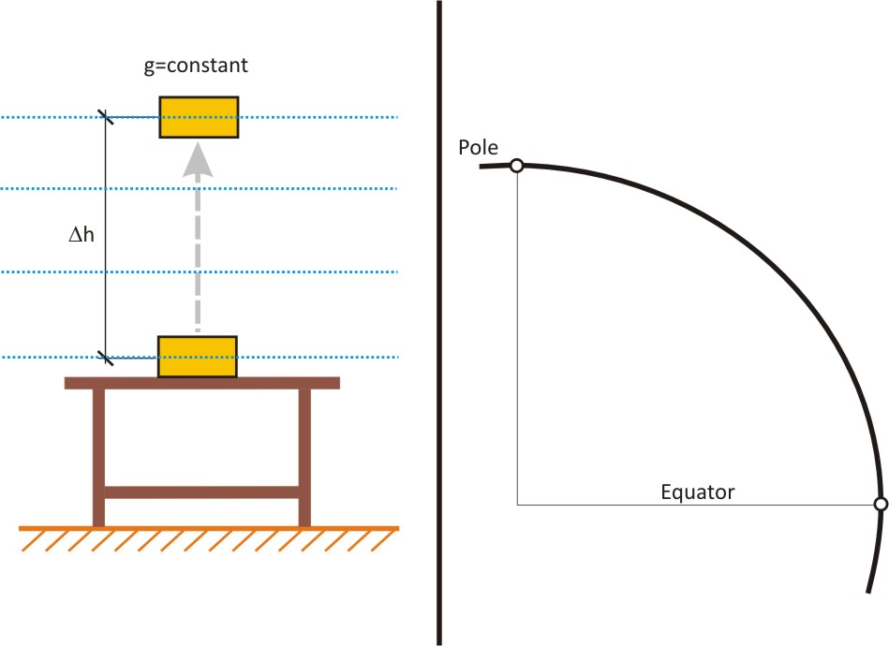
Geodesy
The equipotential surfaces of the gravity field and the plumbline
$$U_{pot.}=mg∆h$$

Slide 16
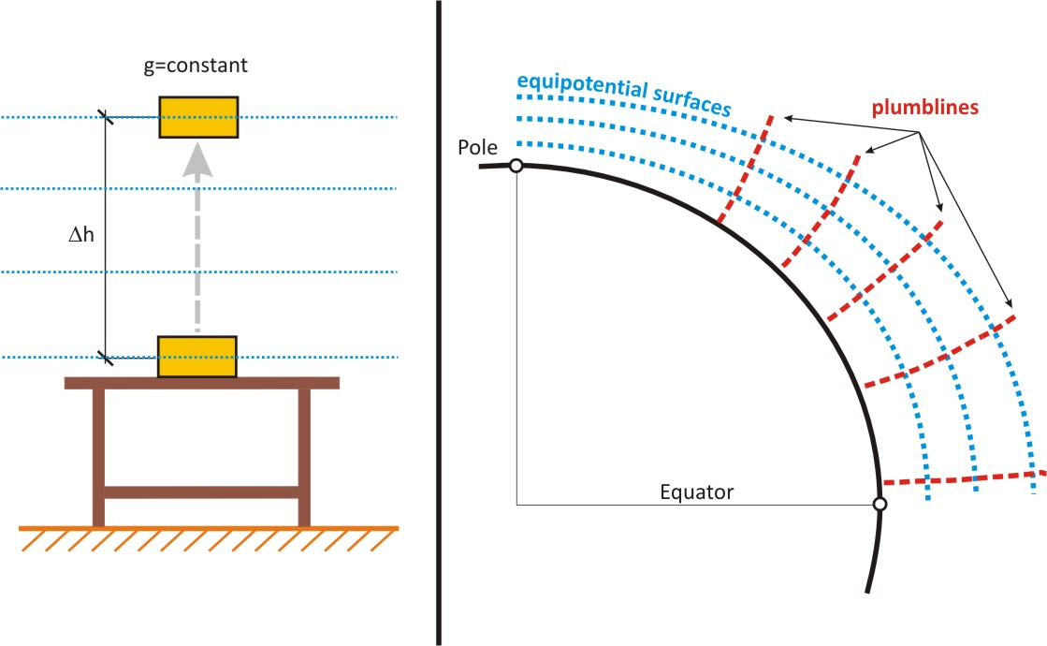
Geodesy
The equipotential surfaces of the gravity field and the plumbline
$$U_{pot.}=mg∆h$$

Slide 17
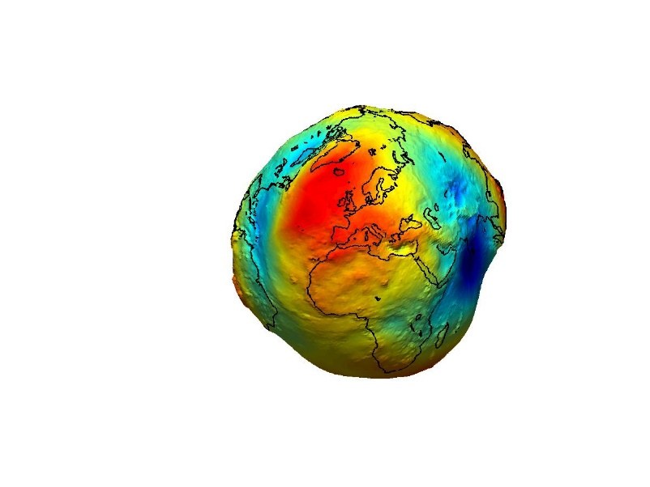
The shape of the Earth
The physical (real) shape of the Earth:
the boundary surface formed by the surface
of the continents (topography) and the sea surface.
The theoretical (mathematical) shape of the Earth:
the surface defined by open water bodies when only the gravity has an effect
on it (equipotential surface)
infinite number of equipotential surfaces
-> the one that coincides with the mean sea level
→ geoid

Slide 18
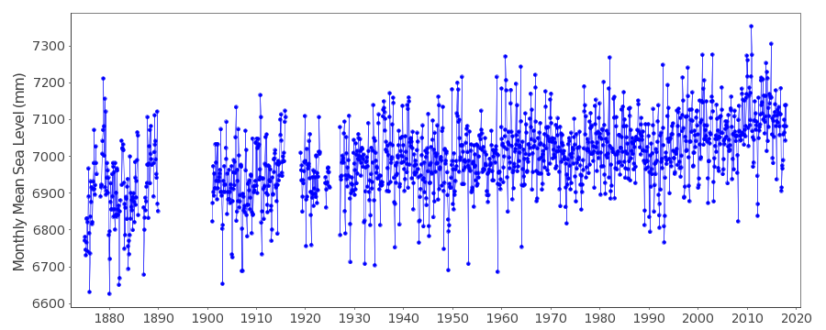
What is the mean sea level?
Time series of the Triest tide gauge (1875-2018)

Slide 19
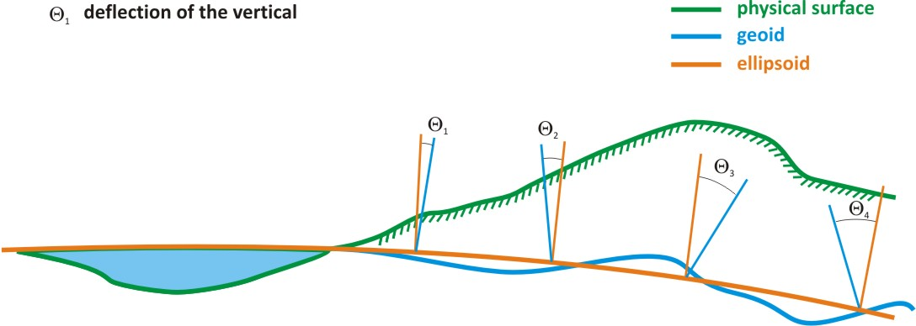
Positioning
Coordinate system:
Fitted to the appropriate reference surface (ellipsoid, sphere, plane)

Slide 20
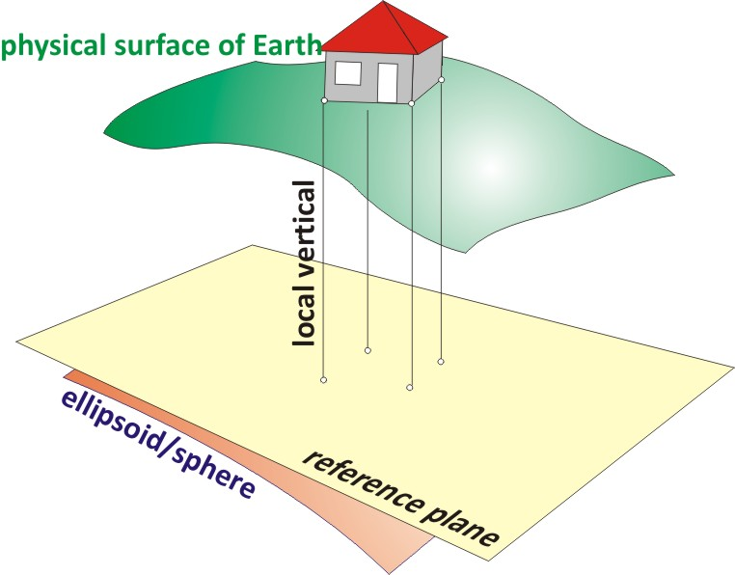
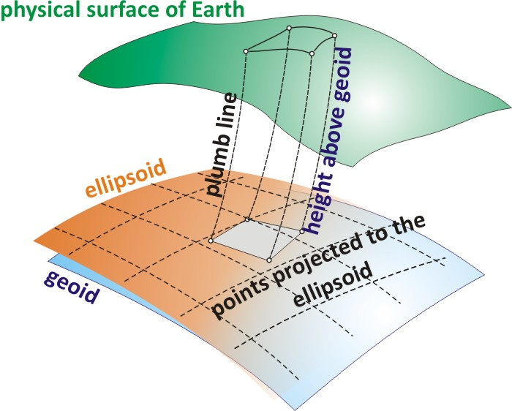
Projections in Geodetic and Plane Surveying
Geodetic surveying
Plane surveying

Slide 21
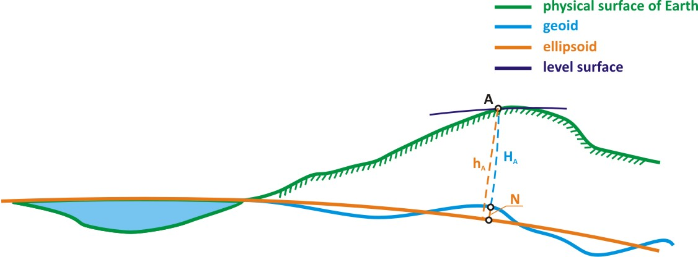
Determination of the height above the ellipsoid:
h = N + H
→ N the distance between the geoid and the ellipsoid (geoid undulation) -> determined by geodesy
→ H the height above the geoid (the mean sea level)

Slide 22
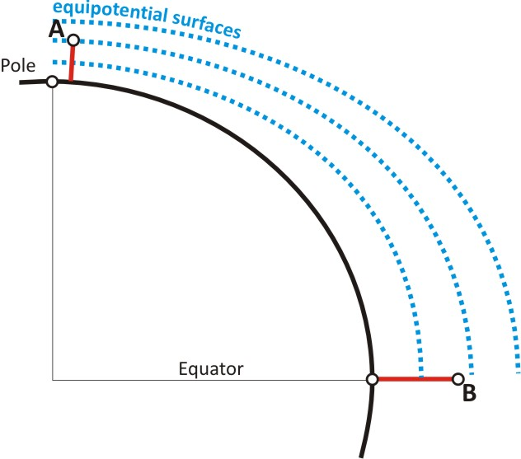
What do we mean by height? What should the height of a point express?
In which direction does the water flow between A and B?

Slide 23
What do we mean by height? What should the height of a point express?
Solution: water flows from A to B!
Heights should express the potential level of the point
Thus:
[m²/s²]
Height systems:
[m]

Slide 24
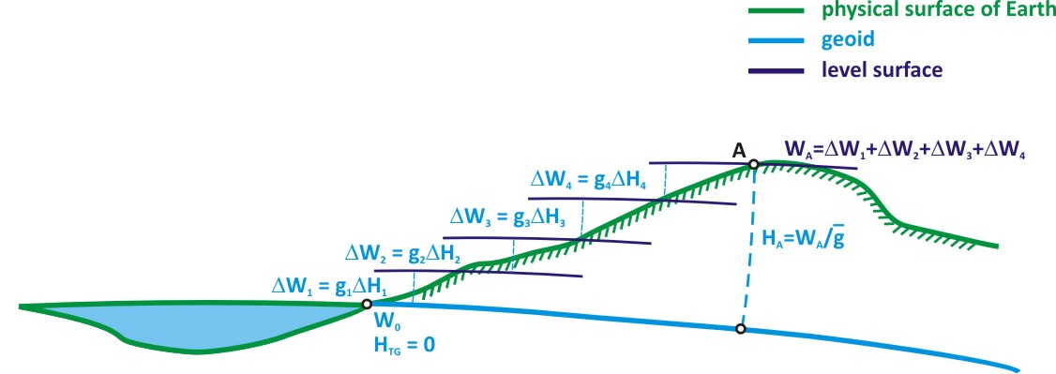
The definition of the reduced level (RL)
Reduced level: the height of the point above a chosen reference mean sea level, called the Datum.

Slide 25
Measuring height differences:
levelling:
- the infinitesimal parts of the level surface are used
(hydrostatic levelling – law of communicating vessels)
- the tangent plane of the level surface is used
(optical levelling),
- the vertical distances from the level surface or its tangent plane are measured
trigonometric heighting
- the height difference is calculated by observing a distance and an elevation angle
in a right triangle in the vertical plane
physical heighting
- Physical quantities are measured, which are related to elevations (e.g. barometric
heighting)

Slide 26
The principle of optical levelling
d_{P}
d_{Q}
Line-of-sight (height of collimation)
Δ_{P}
Δ_{Q}
Level surface of instrument
l_{P}
(l_{P})
Level surface of P
P
l_{Q}
(l_{Q})
ΔRL_{PQ}
Level surface of Q
topography
Q

Slide 27
The principle of optical levelling
d_{P}
d_{Q}
Line-of-sight (height of collimation)
Δ_{P}
Δ_{Q}
Level surface of instrument
l_{P}
(l_{P})
Level surface of P
P
l_{Q}
(l_{Q})
ΔRL_{PQ}
Level surface of Q
topography
Q
$$Δ{RL}_{PQ}^{}={RL}_{Q}−{RL}_{P}=\left(ℓ_{P}\right)−\left(ℓ_{Q}\right)$$
→
$Δ{RL}_{PQ}^{}=ℓ_{P}$- $ℓ_{Q}$

Slide 28
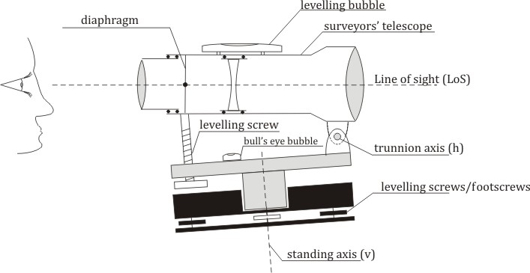
The structure of the tilting (dumpy) level
Alidade / upper part
tribrach

Slide 29
The principle of astronomical telescopes

Slide 30
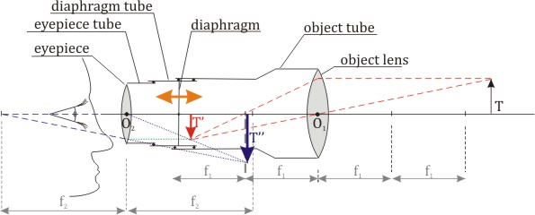
The structure of surveyors’ telescope
Surveyors’ telescope with external focusing

Slide 31
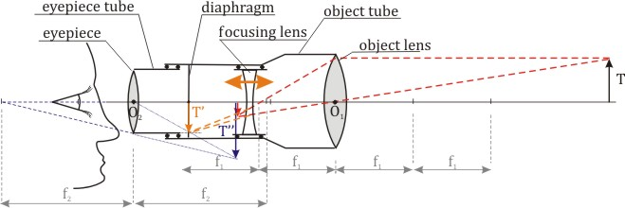
The structure of surveyors’ telescope
Surveyors’ telescope with internal focusing

Slide 32
The parallax
The phenomena of parallax
Note that in case of parallax, the reading changes depending on the position of the observer.

Slide 33
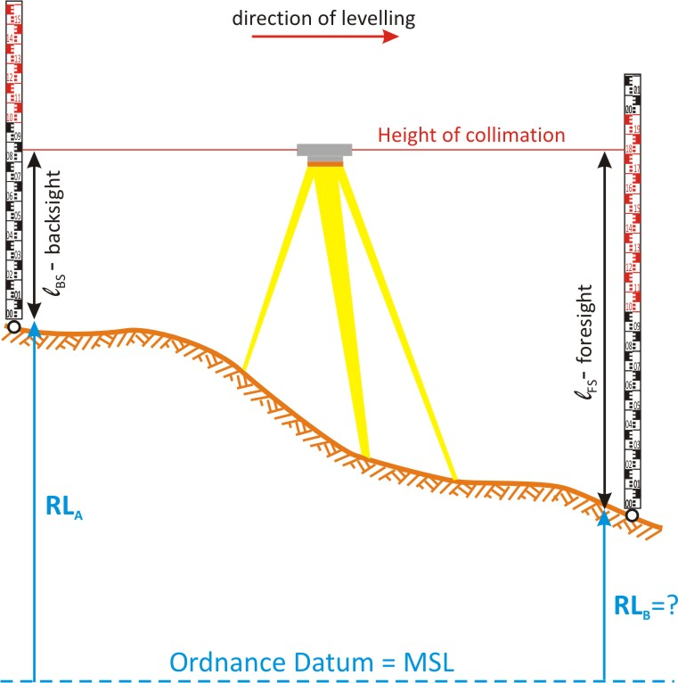
The measurement of height differences using surveyors’ level
$${RL}_{B}={RL}_{A}+\left(l_{BS}−l_{FS}\right)$$

Slide 34
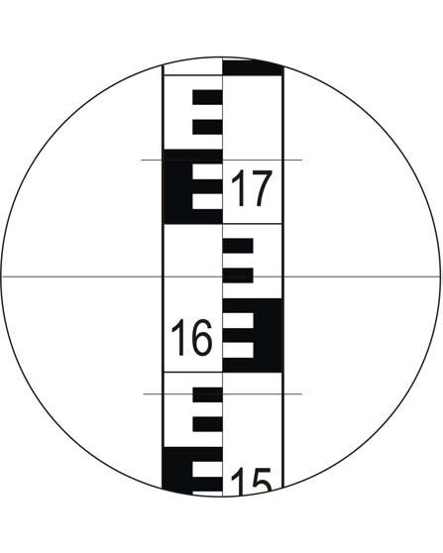
The levelling staff
Staff reading: 1664
Horizontal crosshair
stadia lines

Slide 35
Measuring instrument-staff distance with the stadia lines
Reading on the upper
stadia line: 1743
Reading on the lower
stadia line: 1586
stadia lines

Slide 36
Measuring instrument-staff distance with the stadia lines
Reading on the upper
stadia line: 1743
Reading on the lower
stadia line: 1586
c
d
1743
z
1586
Levelling staff

Slide 37
Measuring instrument-staff distance with the stadia lines
Reading on the upper
stadia line: 1743
Reading on the lower
stadia line: 1586
$$\frac{d}{l_{upper}−l_{lower}}=\frac{c}{z}=100$$
$$d=100∙\left(l_{upper}−l_{lower}\right)$$
$$d=100∙\left(1743mm−1586mm\right)=15,7m$$
c
d
z
1743
1586
Levelling staff

Slide 38
Thank You for your Attention!

