Slide 1
GENERAL SYSTEM OF FORCES IN THE PLANE
y
M₁
Properties:
1) The lines of actions don’t intersect in one point.
2) There can be couples in the system.
F₂
M₂
F₁
F₃
0
x
Questions:
1)When are 2 general systems equivalent?
(F_{i},M_{j}) ≡ (P_{k},W_{l}) This is the equivalence statement
Answer:
When their force projections to the x and y axes are the same: Σ F_{ix} = Σ P_{kx}, Σ F_{iy} = Σ P_{ky} and their moments around the origin is the same.
Σ M⁽⁰⁾_{f} = Σ M⁽⁰⁾_{g} The moment includes the moments of the forces and the couples.

Slide 2
THE THREE FUNDAMENTAL PROBLEMS OF FORCE SYSTEMS
Equivalence problems:
1) Determination of the resultant.
The resultant is a single static object which is equivalent to a given force system.
For the moment, there are 3 single static objects: the force, the couple and the zero force.
The equivalence statement: R ≡ (F_{i}, M_{j})
The corresponding equations in 2D:
R_{x} = Σ F_{ix} , R_{y} = Σ F_{iy} , $±$R_{y}∙x_{R} = Σ M⁽⁰⁾_{j}
R_{y}
x_{R}
R
2) Replacement of a force system to a force and a couple acting in a given point.
This is also called reduction.
The equivalence statement: (R_{o}, M_{o}) ≡ (F_{i}, M_{j})
The corresponding equations in 2D:
R_{ox} = Σ F_{ix} , R_{oy} = Σ F_{iy} , $M$_{o} = Σ M^{(o)}_{j}
Mo
Ro

Slide 3
3) THE EQUILIBRIUM PROBLEM
On the contrary to the equivalence problems, the equlibrium problem concerns only one force system. The question: When is a force system is in equilibrium? The answer: When the resultant is a zero force.
The equilibrium statement: (F_{i}, M_{j}) ≡ 0
The equilibrium equations in 2D:
Σ F_{ix} = 0, Σ F_{iy} = 0, Σ M⁽⁰⁾_{j} = 0
Special cases:
1) Parallel force systems:
In this case we take one axis (for example the y direction) parallel to the common force direction so only one force equation remains: Σ F_{iy} = 0, Σ M⁽⁰⁾_{j} = 0.
2) Concurrent force systems:
We have only the 2 force equations as the moment equation to the common intersection point is automatically satisfied: Σ F_{ix} = 0, Σ F_{iy} = 0.

Slide 4
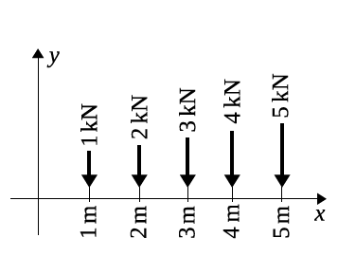
Exercise 1
Find the magnitude and position of the resultant of five forces shown in the figure.
x_{R}
The equivalence statement:
R≡(F1,F2,F3,F4,F5)
The equivalence equations:
R_{y} = Σ F_{iy}
R_{y} = -15 kN
R_{y} ∙ x_{R} = Σ M⁽⁰⁾_{i}
-15 ∙ x_{R} = -1 ∙ 1 - 2 ∙ 2 - 3 ∙ 3 - 4 ∙ 4 - 5 ∙ 5
x_{R} = 3.667m

Slide 5
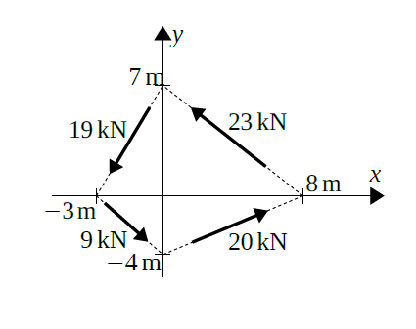
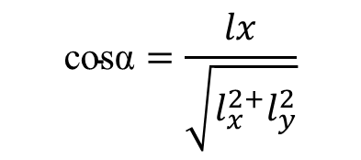
Exercise 2
a)Find the equivalent fource-couple system of the given forces acting in the origin. (Equivalence problem)
b)What kind of resultant do they have?
c)Determine the resultant.
cosα
$$\text{cosα}=\frac{lx}{\sqrt{l_{x}^{2+}l_{y}^{2}}}$$
F2
F1
α₁
It happens many times that the line of action of a force is given by geometrical data. This is the case now as well.
In this case, we have to compute the data of the corresponding geometrical vector. Usually, we name the geometrical vector of the line of action l. We can group their data in a table
d₁
F3
F4
$$l=\sqrt{l_{x}^{2+}l_{y}^{2}}$$
$Fx=F∙\frac{l_{x}}{l}$ $Fy=F∙\frac{l_{y}}{l}$
$$d= \frac{l_{x}∙l_{y}}{l}$$
$$M= \sum{F_{i}∙d_{i}}$$
The resultant is a force as Ro ≠ 0.
Fx=F* cosα
The equivalence statement: (Ro,Mo)≡(F1,F2,F3,F4)
$$M= \sum{|F_{iy}∙l_{xi}|}$$
R_{ox} = Σ F_{ix} , R_{oy} = Σ F_{iy} , $M$_{o} = Σ M^{(o)}_{j}

Slide 6
Determination of the resultant
The startpoint is the result of the reduction shown on the figure.
The equivalence statement: R ≡ (Ro, Mo)
Mo = 464.7 kNm
x_{R}
The equivalence equations: Rx = Rox, Ry = Roy, Ry*x_{R} = Mo
Rox = -1.505kN
-0.5739*x_{R} = 266.71
Roy
Ro =$\sqrt{R_{ox}^{2}+R_{oy}^{2}}$
x_{R} = -464.73m
R
Ro =1.6107 kN
Roy = - 0.5739 kN
Cases of the resultant
Force, if Ro≠0
Couple, if Ro=0, Mo ≠0
Zero force (equilibrium), if
Ro=Mo=0
α_{o} = arc tg Roy/Rox = 20.87ᵒ
The Final Sketch (FS)
It is important that we communicate the result of a computation in an orderly manner. Because of this, the end of every solution is a so called final sketch, were we give the result in a meaningful way.
y
x_{R} = 266.71m
Rox = 1.505kN
α_{o} = 20.87ᵒ
x
Ro =1.6107 kN
If the arrows show the direction of a component, it is not necessary to write the sign.
Roy = 0.5739 kN

Slide 7
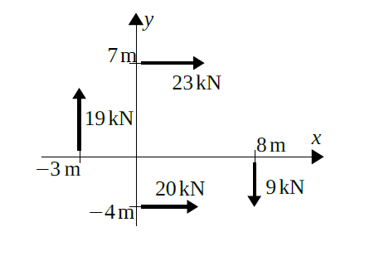

Exercise 3: Equivalence Problem
Find the equivalent force-couple system of the given forces acting in the origin. What kind of resultant do they have? Determine the resultant.
F2
F1
Ry
R
x_{R}
Rx
Equivalence statement: (Ro, Mo) ≡ (F1, F2, F3, F4)
Equivalence equations:
F4
F3
R_{ox} = Σ F_{ix} :
R_{ox} =
43 kN
R_{oy} = Σ F_{iy} :
R_{oy} =
10 kN
$M$_{o} = Σ M^{(o)}_{i} :
M_{o} =
-19 ∙ 3
- 23 ∙ 7
- 9 ∙ 8
+ 20 ∙ 4
= -210 kNm
The resultant: R ≡ (Ro, Mo)
Rx =
43 kN
Ry =
10 kN
Σ M⁽⁰⁾_{i} : -210 = 10 ∙ x_{R}
x_{R} = - 21m

Slide 8
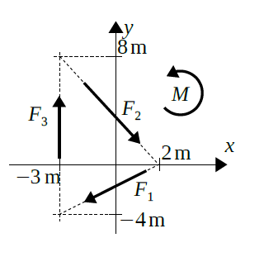
Exercise 4
F1=4.4 kN
F2=6.6 kN
F3=10.1kN M=14kNm
a)Find the equivalent fource-couple system of the
given forces and torque about the origin.
b)What kind of resultant do they have?
c)Determine the resultant. (HW)
(Ro,Mo) ≡ (F1,F2,F3,M)

