Slide 1
The science of motion and rest
MECHANICS
KINEMATICS
The study of the description of the motion without considering the forces
The study of the of the motion by considering the forces
KINETICS
STATICS
Science of rest (equilibrium)
DYNAMICS
Science of motion

Slide 2
The FORCE
It is and imaginary quantity which we use to express the mechanical action of a body to another one. It is a vector because it has a direction (line of action), a sense of action (its arrow) and a magnitude (unit N, kN). The length of the force vector is proportional to the magnitude of the force. For example 1cm (=) 1kN. This is called the force scale.
Forces between two bodies always happen in pair and are opposite. Newton’s 3rd law.
F’
F

Slide 3
PROPERTIES OF FORCES SYSTEMS:
One can classifiy the force systems according to different points of view:
The dimension of the space: Forces in space (3D), forces in the plane (2D).
The relation between the lines of action:
General
Concurrent
Parallel
The nature of the forces:
Concentrated: unit: kN
Distributed: unit: kN/m
In reality, there are only distributed systems of forces.
The concentrated force is an idealization.

Slide 4
THE DATA OF A FORCE
Out of the vector of a force, an other information is necessary to fully charaterize a force and it is the so called point of application. The point of application can be any point of the line of action of the force because the force can be moved along its line of action.
y
So this point can be the intersection of the force with the x axis (x_{F}).
So for a force in the plane there are to different but equivalent set od data.
analytical data: Fx, Fy, x_{F} and
engineering data: F, α, x_{F} .
Fy
F
α
x_{F}
Fx
x
In computations we always use the analytical data.

Slide 5
STATICS, the science of force sytems
There are two approches to study a discipline:
From the more complicated towards the simpler.
From the simpler towards the more complicated.
We chose the 2nd approach. The simplest forces system
in the plane is the system of concurrent forces. We start here.
The fondamental problems of statics: Equivalence and equilibrium.
The equivalence statement: ({F_{i}}) ({Q_{j}})
The equivalence equations:$\sum{F_{i,x}}$ = $\sum{Q_{j,x}}$, $\sum{F_{i,y}}$ = $\sum{Q_{j,y}}$
Two concurrent force systems are equivalent if their force projection is the same in the x and y and z direction.
R

Slide 6
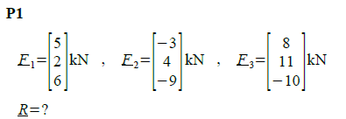
The resultant:
It is a single force which is equivalent to a given force system.
The equivalence statement for the resultant: : R ({F_{i}})
The equivalence equations for the resultant: $R_{x}$= $\sum{F_{i,x}}$, $R_{y}$= $\sum{F_{i,y}}$
In 3D there is also ${ R}_{z}$= $\sum{F_{i,z}}$ R is passing in the intersection point.

Slide 7
EQUILIBRIUM
If the resultant vector of a concurrent for system is 0, then we say that the system is in equilibrium. We express it by the equilibrium statement:
({F_{i}}) 0 and the respective equilibrium equations:
$\sum{F_{i,x}}$ = 0, $\sum{F_{i,y}}$ = 0, $\sum{F_{i,z}}$ = 0
F2
Vector diagram
Scale: 1cm (=) 1kN
VIEW
F1
F1
F3
F2
F3

Slide 8
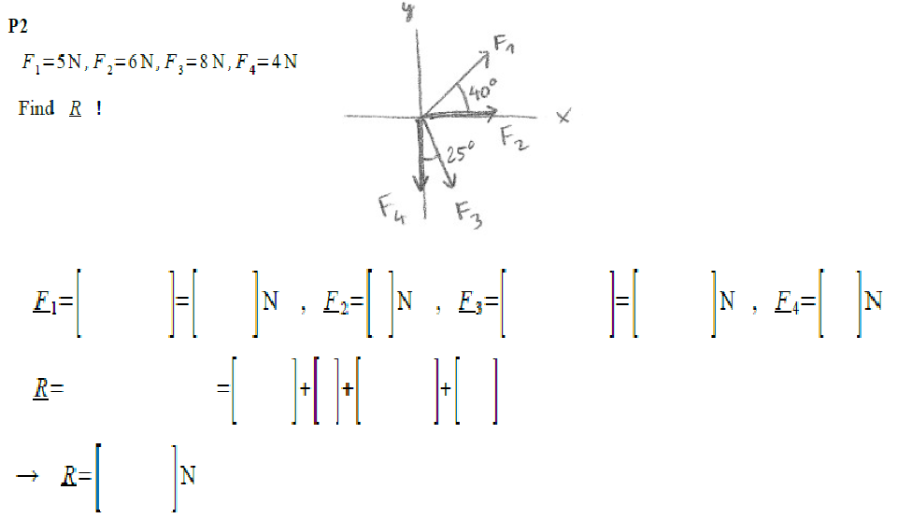

Slide 9
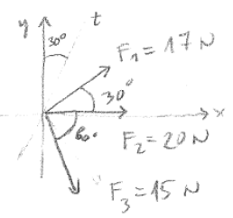
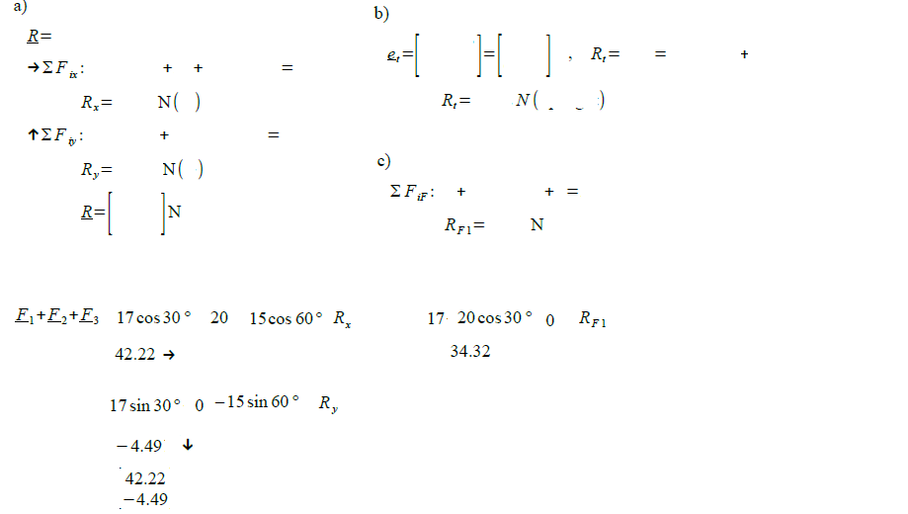
R_{F1} = 42.22*0.866-4.49*0.5 =34.22 N

Slide 10
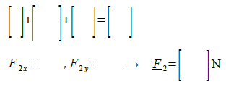

Slide 12
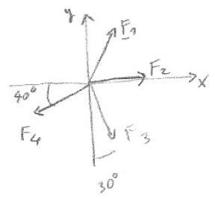
P6. The resultant of the forces (F1, F2, F3, F4 ) is a zero force (i.e. the forces are in equilibrium).
F1and F2 are given, and the directions of the forces F3and F4 are known.
Find the magnitude of F3and F4 .
2
F₃sin30ᵒ
-F₃cos30ᵒ
F₄ = 8/0.766 + 0.5/0.766*F₃ →
7 – 0.866*F₃ – 0.6428*(10.44+0.6527*F₃) = 0 →
7-6.711-(0.866+0.6428*0.6527)*F₃ = 0 → 0.289-1.2856*F₃ = 0 →
F₃ = 0.2247 kN, F₄ = 10.44+0.6527*0.2247 = 10.59 kN

Slide 13
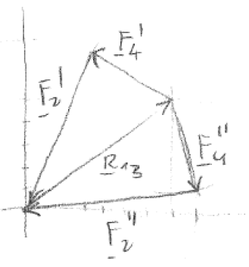
=$\left[\begin{aligned}7 \\ 5\end{aligned}\right]$
R₁₃ is the resultant of R₁ and R₃
The system is in equilibrium
Length of F₂, F₄.

Slide 14
Geometric Conditions of the Equilibrium of Three Forces
Fundamental theorem
1) The three forces should be concurrent.
2) They should be in the same plane.
3) The vector triangle formed from them should be closed and continuous.
View
Vector diagram
1 cm (=) 1 kN
F2
F1
F2
F3
F3
F1

Slide 15
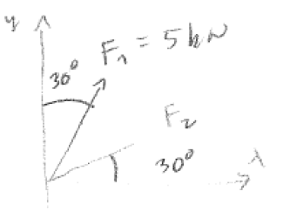
P8. The resultant of the forces (F1, F2, F3 ) is a zero force (i.e. the forces are in equilibrium).
F1 is given, the direction of the force F2 and the magnitude of the force F3 is known.
Find the magnitude of F2 and the direction of F3 .
F₃ = 4kN
t
30⁰
F₁+F₂+F₃ = 0 The resultant vector is 0. This means that the vector diagram is closed and continuous in arrow.
30⁰
The grapho-analytical method: We observe the properties of the vector diagram and we use computation to obtain the result.
ΣF_{it} = 5*cos60ᵒ – 4*cosα = 0
F₃
t
F₁ = 5
α_{3t} = 51.32ᵒ
α
F_{3,II}
h
h =
5*sin30ᵒ
= 2.500
F_{3,I}
s
90-α
F₂
s =
h*tan(α)
F_{1,2}
s =
2,500*tan(51.32ᵒ)=
3.123
F_{1,2} =
5*cos30ᵒ =
4.330
F₃
F_{2,I}
α
F_{2,II}
F_{2,I} =
F_{1,2} – s =
1.207kN
F₂
F_{2.II} =
F_{1,2} + s =
7.453 kN

Slide 16
If a force system is in equilibrium then its projection to any axis is 0.
Data
How do we construct the solution?
1) We define an axis t which is perpendicular to the direction of F₂, so has 30⁰ to the y axis.
NoNo | F | α_{x}
1 | 5 | 60
2 | ? | 30
3 | 4 | ?
t
ΣF_{it} = 5*cos60ᵒ – 4*cosα = 0
Solution géométrique
F₁ = 5
α_{3t} = 51.32ᵒ
30⁰
30⁰
α
F_{3,II}
h =
5*sin30ᵒ
= 2.500
F3
F_{3,I}
h
s
F₂
s =
h*tan(α)
F1
90-α
F_{1,2}
30⁰
s =
2,500*tan(51.32ᵒ)=
F_{2,I}
F_{1,2} =
5*cos30ᵒ =
4.330
α_{t3}
F2
F_{2,II}
F_{2,I} =
F_{1,2} – s =
1.207kN
F_{2.II} =
F_{1,2} + s =
7.453 kN

