Slide 1
Surveying I. Lecture 5.
Geodetic map projections. National control networks. Geodetic informations: point descriptions, maps.
Lóránt Földváry
2024. November 04.

Slide 2
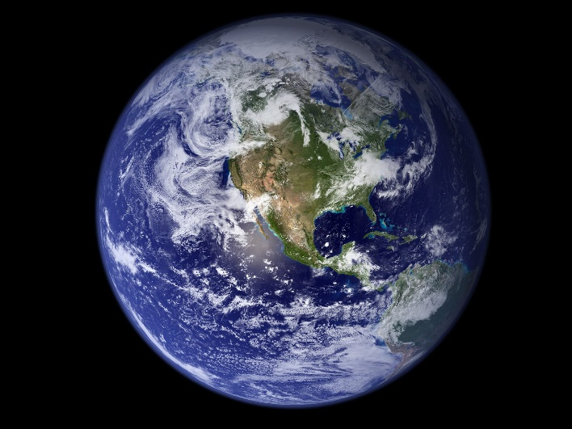
Map Projections
The result of surveying measurements are geometrical information (distances, angles) in a local horizontal/vertical system. In order to map the physical shape of the Earth, a reference surface (usually rotation ellipsoid) is used, which is a geometrical body, fitting smoothly to the geoid. Then, the measurements are reduced to the reference surface, a mathematically regular body, in order to treat them with mathematical tools, and derive maps.

Slide 3
Map Projections
The result of surveying measurements are geometrical information (distances, angles) in a local horizontal/vertical system. In order to map the physical shape of the Earth, a reference surface (usually rotation ellipsoid) is used, which is a geometrical body, fitting smoothly to the geoid. Then, the measurements are reduced to the reference surface, a mathematically regular body, in order to treat them with mathematical tools, and derive maps.

Slide 4
Map Projections
The result of surveying measurements are geometrical information (distances, angles) in a local horizontal/vertical system. In order to map the physical shape of the Earth, a reference surface (usually rotation ellipsoid) is used, which is a geometrical body, fitting smoothly to the geoid. Then, the measurements are reduced to the reference surface, a mathematically regular body, in order to treat them with mathematical tools, and derive maps.
The term map projection refers to the process of projecting geometrical information from the reference surface to a plane projection surface, allowing the representation of the geometrical content on a map.
projection surface
(E,N)
reference surface
(Φ,Λ)

Slide 5
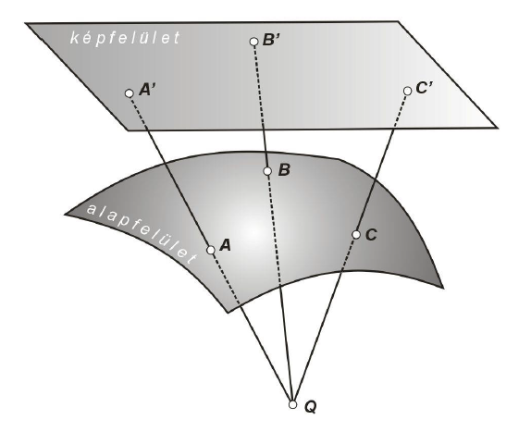
Map Projection
Map projection is performed with the use of mapping equations, defining the transformation between the geographical (Φ,Λ) and plane (E,N) coordinates.
Method of map projection:
- perspective projection: the mapping equations refer to a geometrical transformation.
- mathematical projection: the mapping equations does not corresponds
to geometry.
projection surface
(E,N)
reference surface
(Φ,Λ)

Slide 6
Distortion of map projections
Shapes on the reference surface cannot be represented on the projection surface without distortion. In general, due to the map projection all metrics,
- distance
- angle
- area
get distroted.
In special cases, certain metrics remain preserved.
(E,N)
(Φ,Λ)

Slide 7
Distortion of map projections
Projections when certain is preserved:
Conformal projection:
preserves angles
Equal-area projection:
preserves area
Equidistant projection:
preserves distances
BUT! Distance cannot be preserved generally, only along special direction (not isotropic)
(E,N)
(Φ,Λ)

Slide 8
Distortion of map projections
For engineering purposes, generally the conformal map projection is applied (preserving angles).
Additionally, maps used for engineering are defined to have locally (around the centre of the origin) „small” distortion of the distance. So practically, over „small” regions it can be considered to efficiently preserving the shape.
(E,N)
(Φ,Λ)

Slide 9
Scale of a Map
Nominal map scale is defined as (e.g.)
Sc = 1:10.000
This ratio is defined after the projection is done, so it refers to distorted distances.
Actual map scale takes into account the distortion of the distance
(E,N)
$$Scale= \frac{distance on the map}{distance on the projection surface}$$
(Φ,Λ)
$$Scale= \frac{distance on the map}{distance on the reference surface}$$

Slide 10
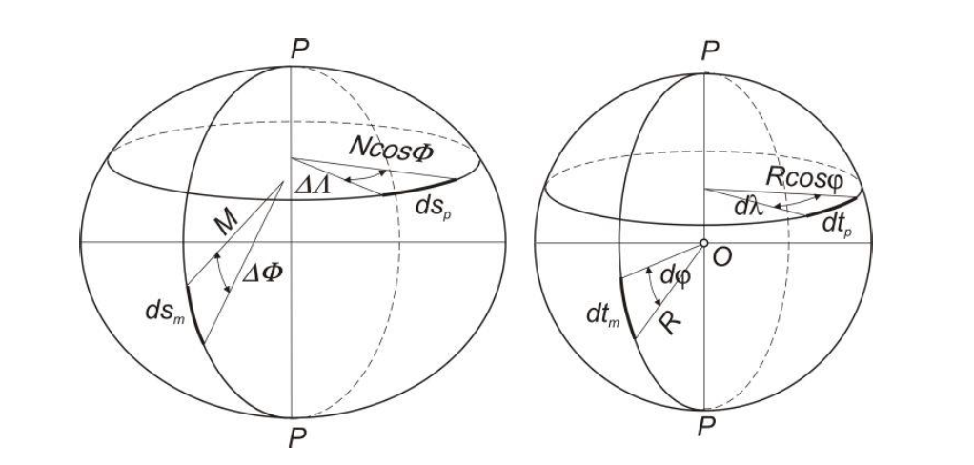
Reference Surfaces
Ellipsoid (rotational, oblate)
Sphere

Slide 11
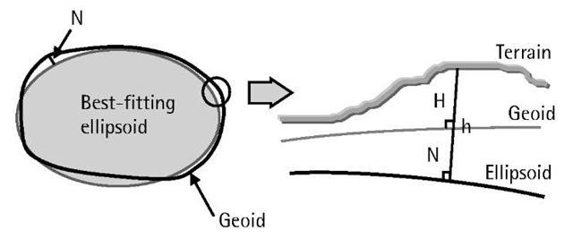
Reference Surfaces
Ellipsoid (rotational, oblate)
Sphere
There are several estimates of a best-fitting ellipsoid, accordingly, they have different parameters (semi-major axis, oblateness)

Slide 12
Reference Surfaces
Most well-known ellipsoids:
Bessel
Hayford
Krasovsky
GRS-80
WGS-84
There are several estimates of a best-fitting ellipsoid, accordingly, they have different parameters (semi-major axis, oblateness)

Slide 13
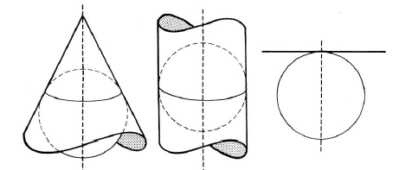
Projection Surfaces
Cone: conic projection
Cylinder: cylindrical projection
Plane: azimuthal projection

Slide 14
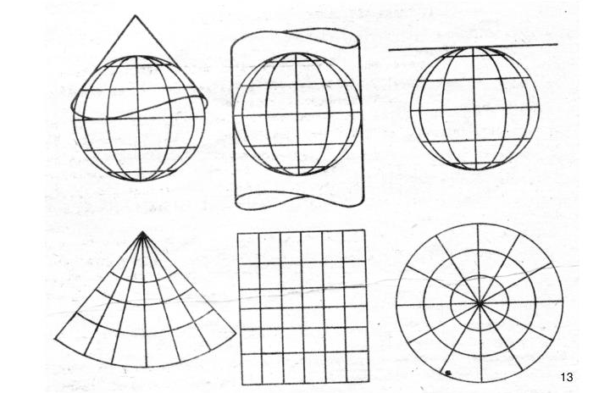
Projection Surfaces
Cone: conic projection
Cylinder: cylindrical projection
Plane: azimuthal projection

Slide 15
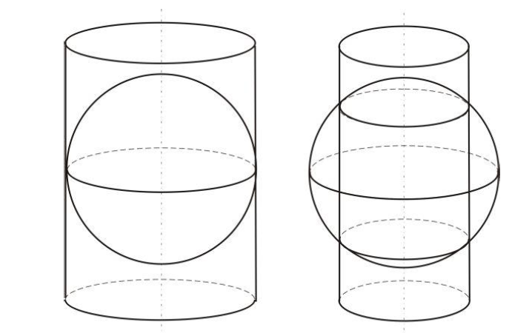
Relative position of
reference surface and projection surface
Tangent:
the two surfaces are in tangential position
Secant:
the two surfaces intersect each other
Note: the line of tangent / intersection is free of distortions!

Slide 16
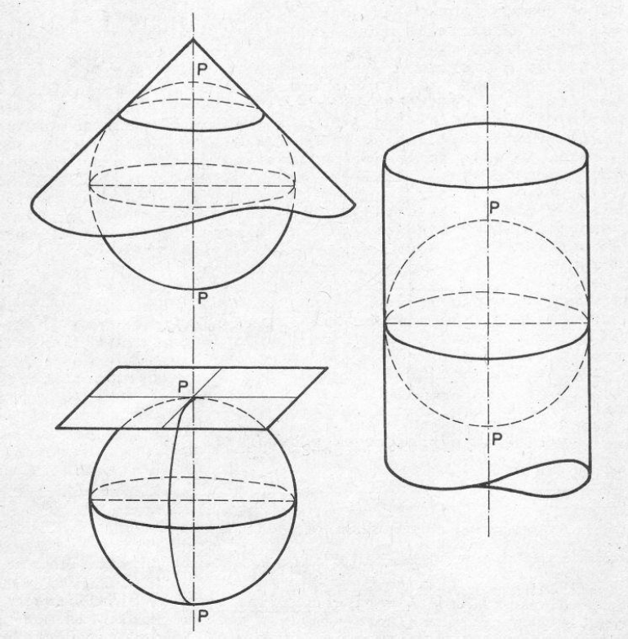
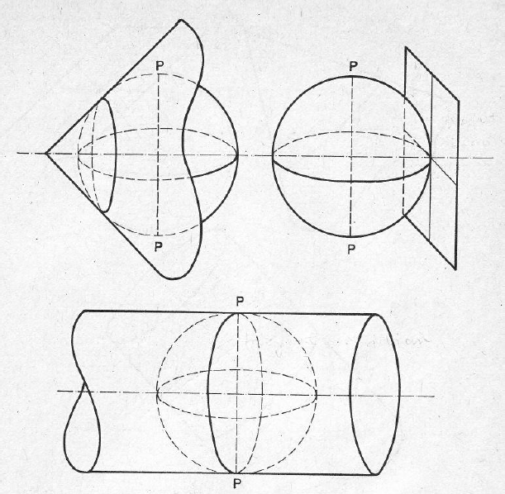
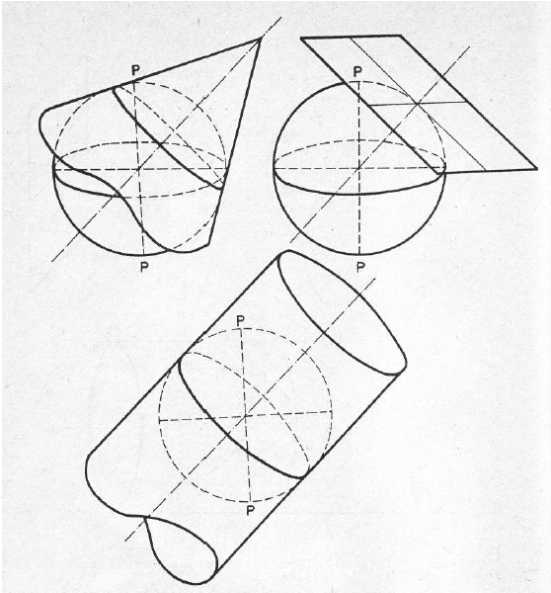
Direction of the projection surface normal
Normal: the normal of the projection surface includes the poles
Transversal: the normal of the projection surface lies in the equatorial plane
Oblique: none of the above

Slide 17
Various projections
Conic projections:
- Equidistant conic: preserving distance along meridians
- Albers conic: equal-areal
- Lambert conic: conformal
Cylindrical projections:
- Lambert cylindrical equal-area: equal-area, undistorted at the equator
- Mercator: conformal
Azimuthal projections:
- Azimuthal equidistant: preserving distance along meridians
- Lambert azimuthal equal-area: preserving area
- Stereographic: conformal

Slide 18
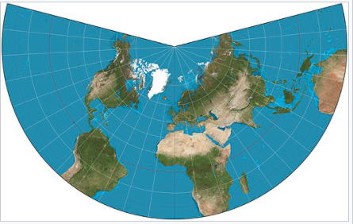
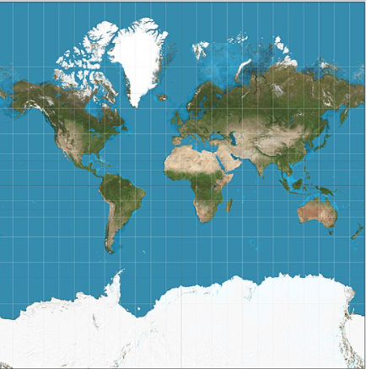
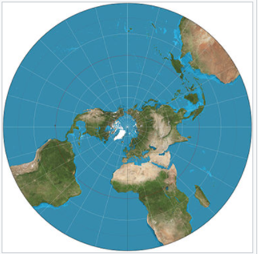
Geodetic projections
Conic conformal projection:
- Lambert conic
Cylindrical conformal projections:
- Mercator
Azimuthal conformal projections:
- Stereographic

Slide 19
Geodetic projections
Mapping equations:
Conic conformal projection:
- Lambert conic
Cylindrical conformal projections:
- Mercator
Azimuthal conformal projections:
- Stereographic
(ϕ,λ) ↔ (x,y)
(ϕ,λ) ↔ (x,y)
(ϕ,λ) ↔ (r,θ)

Slide 20
Map projections in practice
National map projections:
Defined and used for a certain region, usually for a country, optimized by considering the geometry and location of the country
„Optimized”: the used map projection should minimize the distortion of the distances within the area of the country.
For engineering and land registry applications, optimally the maximal distortion of the distance should not exceed ±10 cm/km.
If it is exceeded, for civil engineering tasks a local coordinate system should be used.
All countries use a national map projection system for activities within the border of the country (e.g. land registry)

Slide 21
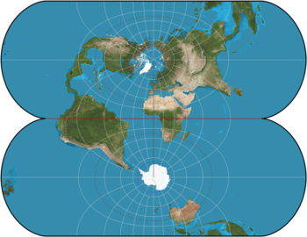
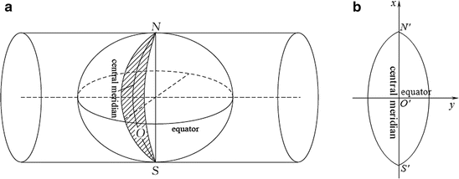
Map projections in practice
International map projections:
Defined and used for the whole globe, or over continent-scale regions
The origin is at the centre of mass of the Earth (geocentric), the z-axis towards to the rotational axis of the Earth
The global mapping is achieved by dividing the map into bands/zones
All countries use an international map projection system for activities outside the border of the country (e.g. military)

Slide 22
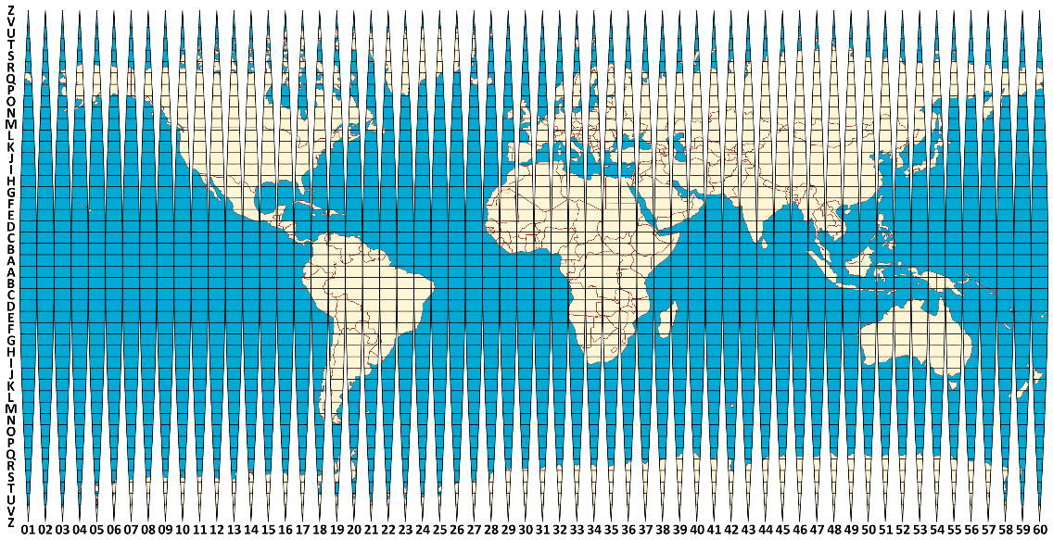
Gauss-Krüger projection
(a.k.a. Transverse Mercator in the US)
Reference surface:
- Bessel ellipsoid
- Hayford ellipsoid
- Krasovsky (SK-42) ellipsoid
Projection surface: cylinder
Tangent/secant: tangent
Orientation: transversal
Bands: 6°, (3°, 2°)

Slide 23
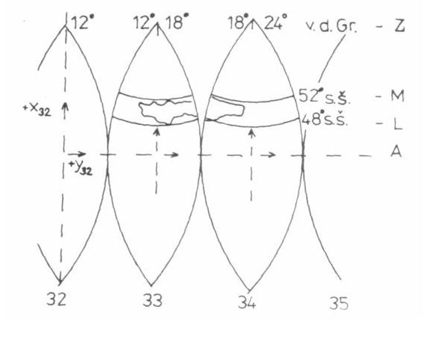
Gauss-Krüger projection
(a.k.a. Transverse Mercator in the US)
Reference surface:
- Bessel ellipsoid
- Hayford ellipsoid
- Krasovsky (SK-42) ellipsoid
Projection surface: cylinder
Tangent/secant: tangent
Orientation: transversal
Bands: 6°, (3°, 2°)
x
x
x
y
y
y

Slide 24
Gauss-Krüger projection
(a.k.a. Transverse Mercator in the US)
Zones:
From South to
North: A … Z
From 180° to
East: 01 … 60
Example:
Hungary is in
zones M-33,
M-34, L-33 and
L-34

Slide 25
Gauss-Krüger projection
52°
(a.k.a. Transverse Mercator in the US)
Zones:
From South to
North: A … Z
From 180° to
East: 01 … 60
M–33
M–34
48°
L–33
L–34
44°
12°
18°
24°
L–33
L–33–65
1
2
3
4
5
6
7
8
9
10
11
12
13
14
24
a
b
Example:
Budapest, BME building K
zone: L-34-15-Ca
coordinates:
y=4353574, x=5262736
A
B
1
c
2
d
53
3
4
64
65
66
77
C
D
133
143
144

Slide 26
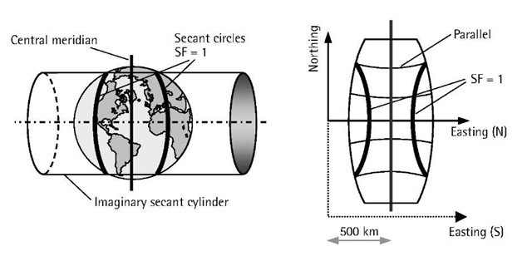
UTM projection
(abbr. of Universal Transverse Mercator)
Reference surface:
- WGS-84 ellipsoid
Projection surface: cylinder
Tangent/secant: secant
Orientation: transversal
Bands: 6°, (3°, 2°)

Slide 27
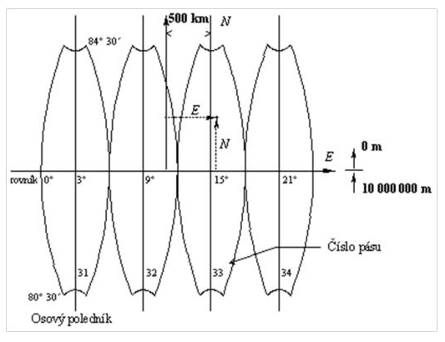
UTM projection
(Universal Transverse Mercator)
Reference surface:
- WGS-84 ellipsoid
Projection surface: cylinder
Tangent/secant: secant
Orientation: transversal
Bands: 6°, (3°, 2°)

Slide 28
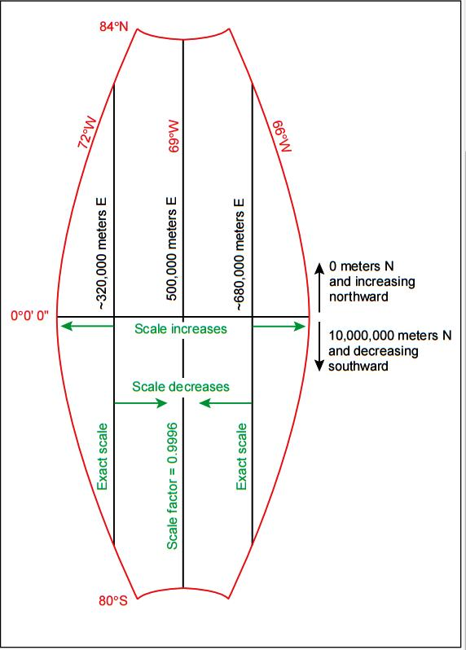
UTM projection
(Universal Transverse Mercator)
Reference surface:
- WGS-84 ellipsoid
Projection surface: cylinder
Tangent/secant: secant
Orientation: transversal
Bands: 6°, (3°, 2°)

Slide 29
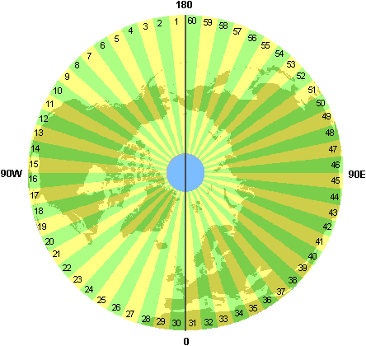
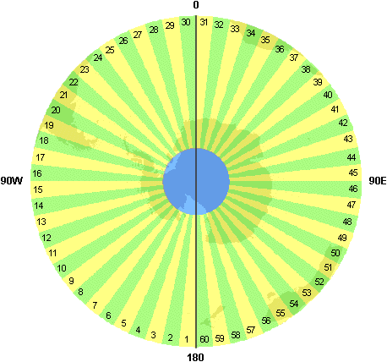
UTM projection
(Universal Transverse Mercator)
Reference surface:
- WGS-84 ellipsoid
Projection surface: cylinder
Tangent/secant: secant
Orientation: transversal
Bands: 6°, (3°, 2°)
There are gaps at the poles with UTM.
The gap is covered by UPS (Universal Polar Stereographic) system

Slide 30
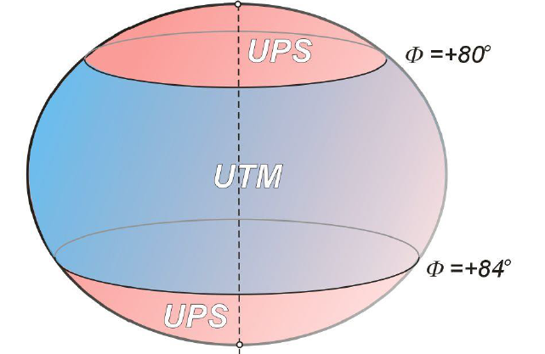
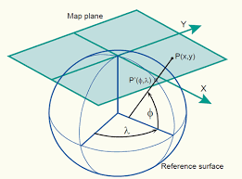
UTM projection
(Universal Transverse Mercator)
Reference surface:
- WGS-84 ellipsoid
Projection surface: cylinder
Tangent/secant: secant
Orientation: transversal
Bands: 6°, (3°, 2°)
There are gaps at the poles with UTM.
The gap is covered by UPS (Universal Polar Stereographic) systems

Slide 31
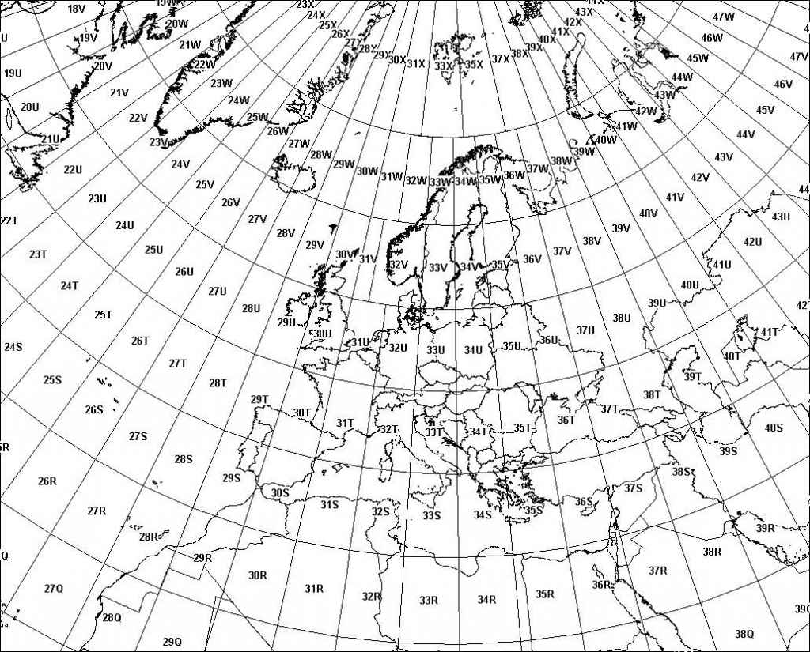
UTM projection
(Universal Transverse Mercator)
Reference surface:
- WGS-84 ellipsoid
Projection surface: cylinder
Tangent/secant: secant
Orientation: transversal
Bands: 6°, (3°, 2°)
From South to North: A … Z
From 180° to East: 1 … 60

Slide 32
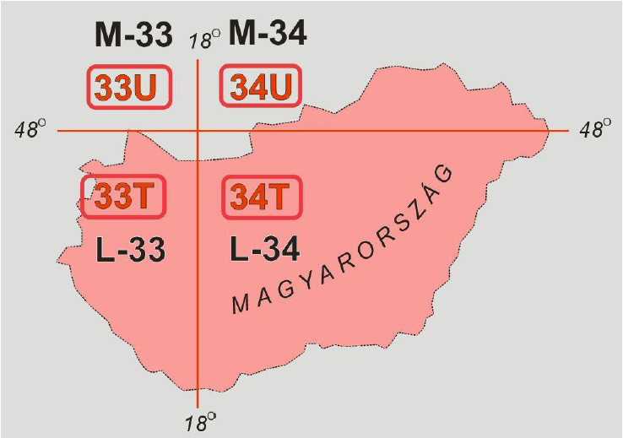
UTM projection
(Universal Transverse Mercator)
Reference surface:
- WGS-84 ellipsoid
Projection surface: cylinder
Tangent/secant: secant
Orientation: transversal
Bands: 6°, (3°, 2°)
Example:
Budapest, BME building K
coordinates:
y=34T353509,
x=34T5260501

Slide 33
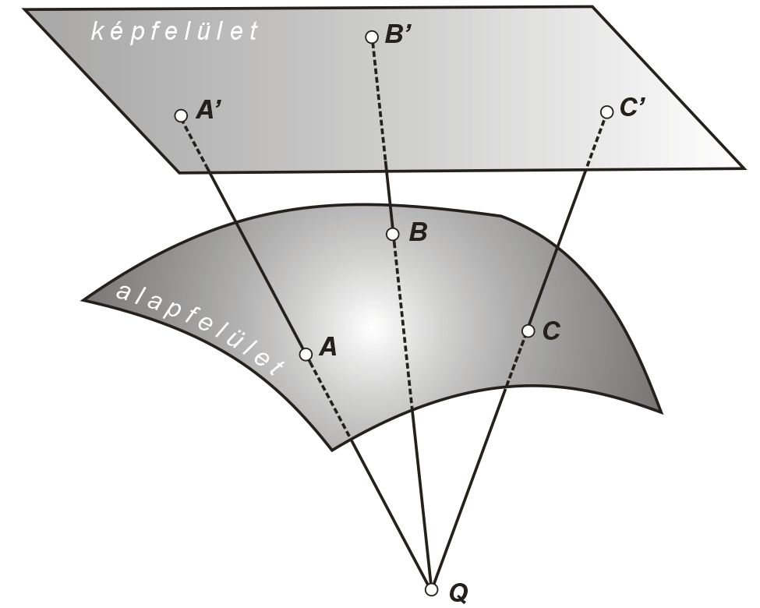
Transformations
2nd projection surface
A’’
B’’
1st projection surface
C’’
Demand:
Provide coordinates of a point known in one projection system in another system.
Such transformation can be applied
between two different system
between zones of the same system
local and official systems
reference surface

Slide 34
Transformations
Such a transformation can be performed by making use of the mapping equations of the two systems, if they have common reference surface. Otherwise, in most cases, transformations between coordinate systems can be performed based on points with known coordinates in both systems. This case the transformation is done by Helmert (or similarity) transformation.
In this case, first parameters of a transformation function is determined based on the coordinates of mutually known points. Then, the transformation function can applied to any other points (known in one system) to calculate their coordinates in the other system.

Slide 35
Transformations
Such a transformation can be performed by making use of the mapping equations of the two systems, if they have common reference surface. Otherwise, in most cases, transformations between coordinate systems can be performed based on points with known coordinates in both systems. This case the transformation is done by Helmert (or similarity) transformation.
In this case, first parameters of a transformation function is determined based on the coordinates of mutually known points. Then, the transformation function can applied to any other points (known in one system) to calculate their coordinates in the other system.

Slide 36
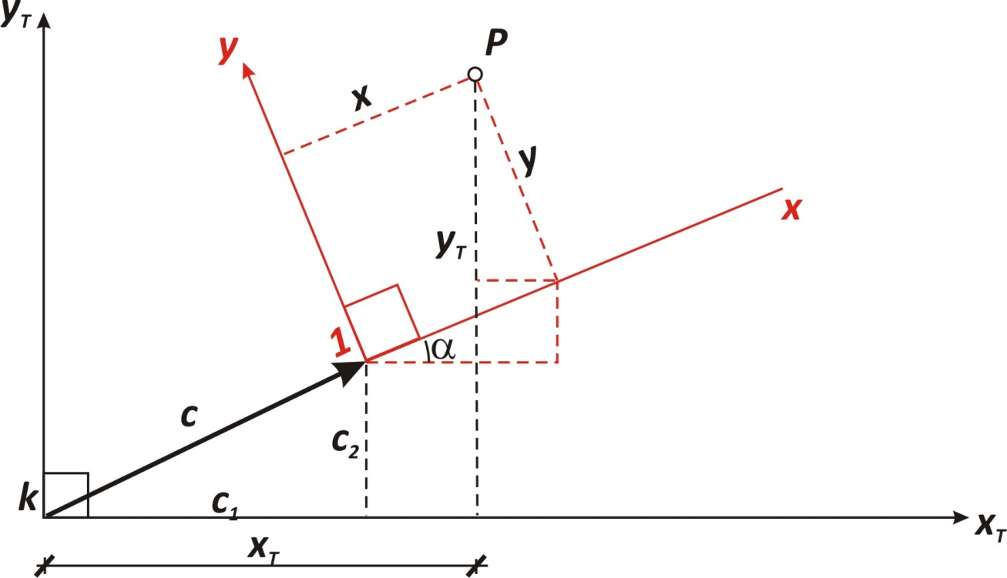
Transformations
In 2D, the Helmert transformation consists of a translation (2 parameters) and a rotation (1 parameter). In case the coordinate axes are different, also a scale factor (1 parameter) should be applied. For this reason it is also called 4-parameter transformation.
$\left[\begin{aligned}&Y_{\left(2.\right)} \\ &X_{\left(2.\right)}\end{aligned}\right]=sc\left[\begin{matrix}cosα & −sinα \\ sinα & cosα\end{matrix}\right]\left[\begin{aligned}&Y_{\left(1.\right)}−∆Y \\ &X_{\left(1.\right)}−∆X\end{aligned}\right]$ $=$ $\left[\begin{matrix}a & −b \\ b & a\end{matrix}\right]\left[\begin{aligned}&Y_{\left(1.\right)}−∆Y \\ &X_{\left(1.\right)}−∆X\end{aligned}\right]$

Slide 37
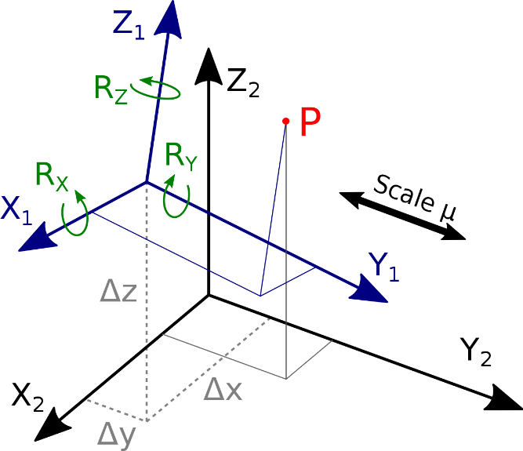
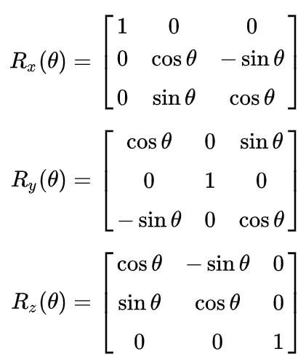
Transformations
In 3D, it consists of a translation (3 parameters), rotations (3 parameter), and, in case of different scaling, a scale factor (1 parameter). This is called the 7-parameter transformation.
$$\left[\begin{aligned}&X_{\left(2.\right)} \\ &Y_{\left(2.\right)} \\ &Z_{\left(2.\right)}\end{aligned}\right]=sc \underline{\underline{R}} \left[\begin{aligned}&X_{\left(1.\right)}−∆X \\ &Y_{\left(1.\right)}−∆Y \\ &Z_{\left(1.\right)}−∆Z\end{aligned}\right]$$
$$\underline{\underline{R}} = \underline{\underline{R_{X}}}\left(α\right) \underline{\underline{R_{Y}}}\left(β\right)\underline{\underline{R_{Z}}}\left(γ\right)$$

Slide 38
Geodetic control networks
Positioning:
theory: task of geodesy
practice: task of surveying
Positioning refers to the determination of the position of characteristic points of natural or man-made objects on the ground (or above/below). These characteristic points are called detail points. The task of determining the detail points is referred to as detail survey.
In order to reduce the propagation of measurement errors, detail surveys are performed with respect to control points, which are stations of the control network.

Slide 39
Geodetic control networks
Positioning:
theory: task of geodesy
practice: task of surveying
Positioning refers to the determination of the position of characteristic points of natural or man-made objects on the ground (or above/below). These characteristic points are called detail points. The task of determining the detail points is referred to as detail survey.
In order to reduce the propagation of measurement errors, detail surveys are performed with respect to control points, which are stations of the control network.

Slide 40
Geodetic control networks
The geodetic control networks consist of control stations of different orders, providing a hierarchy among the control network points. Higher-order networks (e.g. 1st, 2nd or 3rd order, depending on the country’s practice) are established with stations over long distances with homogeneous distribution of the area, then these are densified with lower-order control network points (e.g. 3rd, 4th or 5th order). Higher-order stations are normally determined with more precise tools and methods, accordingly, they may presumably be more accurate.
Classical geodetic control networks contain separately horizontal and vertical networks, according to the measurement methods. Both horizontal and vertical control networks are arranged in hierarchic manner.
Detail surveys are tied to control network points.

Slide 41
Geodetic control networks
The geodetic control networks consist of control stations of different orders, providing a hierarchy among the control network points. Higher-order networks (e.g. 1st, 2nd or 3rdorder, depending on the country’s practice) are established with stations over long distances with homogeneous distribution of the area, then these are densified with lower-order control network points (e.g. 3rd, 4th or 5th order). Higher-order stations are normally determined with more precise tools and methods, accordingly, they may presumably be more accurate.
Classical geodetic control networks contain separately horizontal and vertical networks, according to the measurement methods. Both horizontal and vertical control networks are arranged in hierarchic manner.
Detail surveys are tied to control network points.

Slide 42
Geodetic control networks
The geodetic control networks consist of control stations of different orders, providing a hierarchy among the control network points. Higher-order networks (e.g. 1st, 2nd or 3rdorder, depending on the country’s practice) are established with stations over long distances with homogeneous distribution of the area, then these are densified with lower-order control network points (e.g. 3rd, 4th or 5th order). Higher-order stations are normally determined with more precise tools and methods, accordingly, they may presumably be more accurate.
Classical geodetic control networks contain separately horizontal and vertical networks, according to the measurement methods. Both horizontal and vertical control networks are arranged in hierarchic manner.
Detail surveys are tied to control network points.

Slide 43
Geodetic control networks
Example: Hungary
order network: 140 points
order network: inside the 1st order triangles
order network: covering the whole country (2120 points)
IV. order network: resolution of about 2 km, appr. 48.000 points
V. order network: more points, but no homogeneous distribution

Slide 44
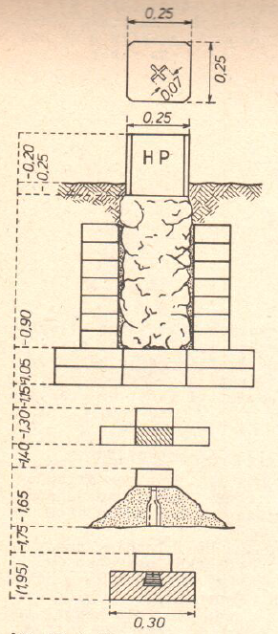
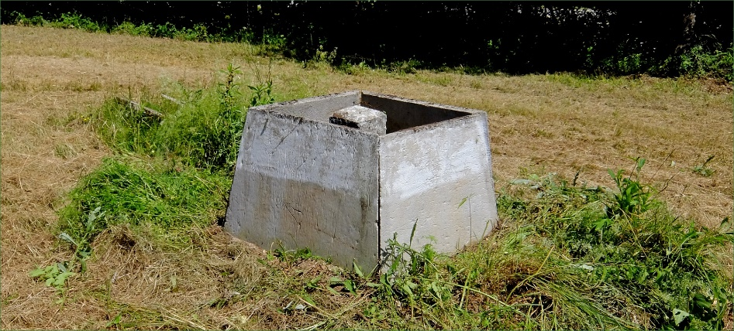
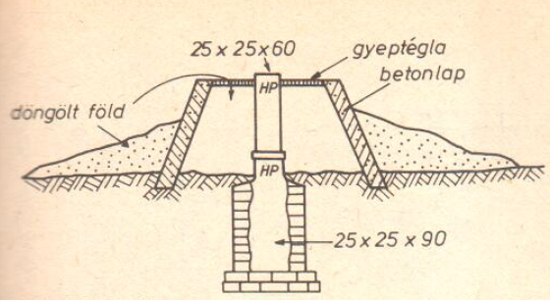
Horizontal geodetic control network points

Slide 45
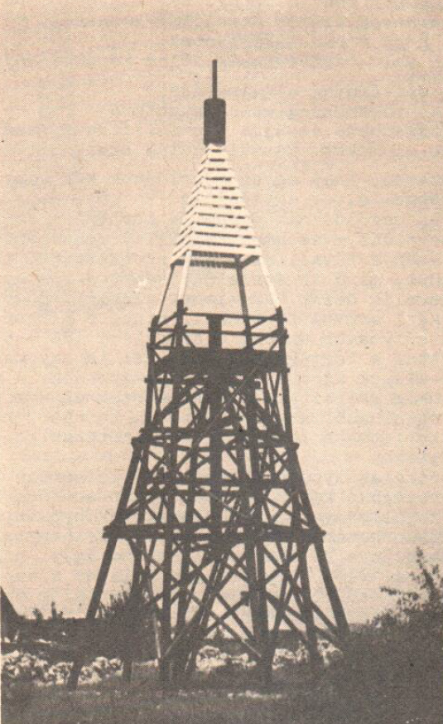
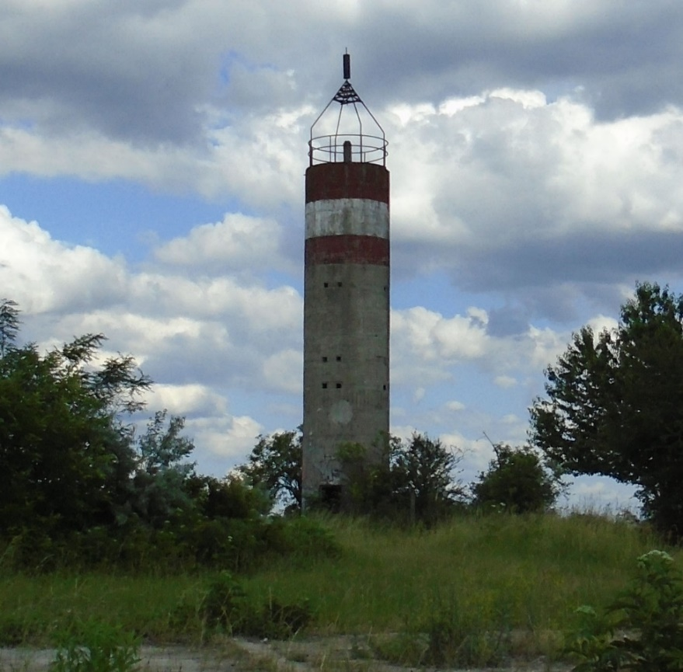
Horizontal geodetic control network points

Slide 46
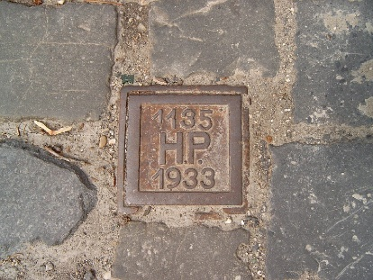
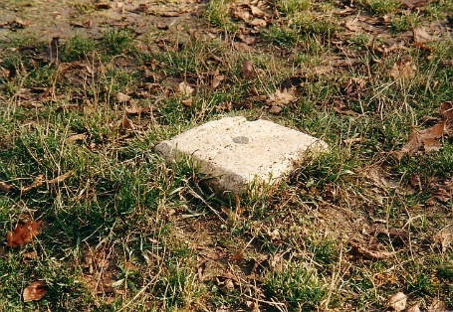
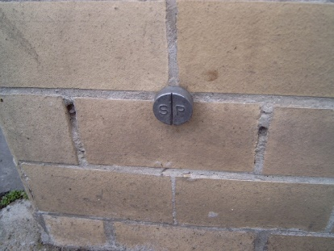
Vertical geodetic control network points

Slide 47
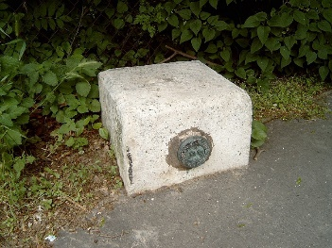
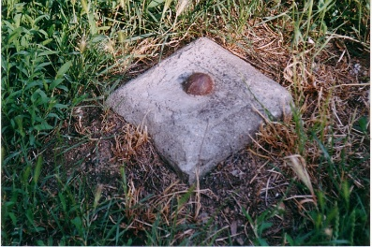
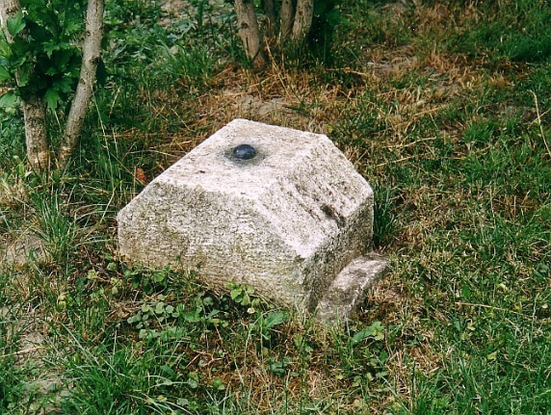
Vertical geodetic control network points
20 cm
10 cm
védőkupak
~8 cm
90 cm
40 cm
csömöszölt betonalap

Slide 48
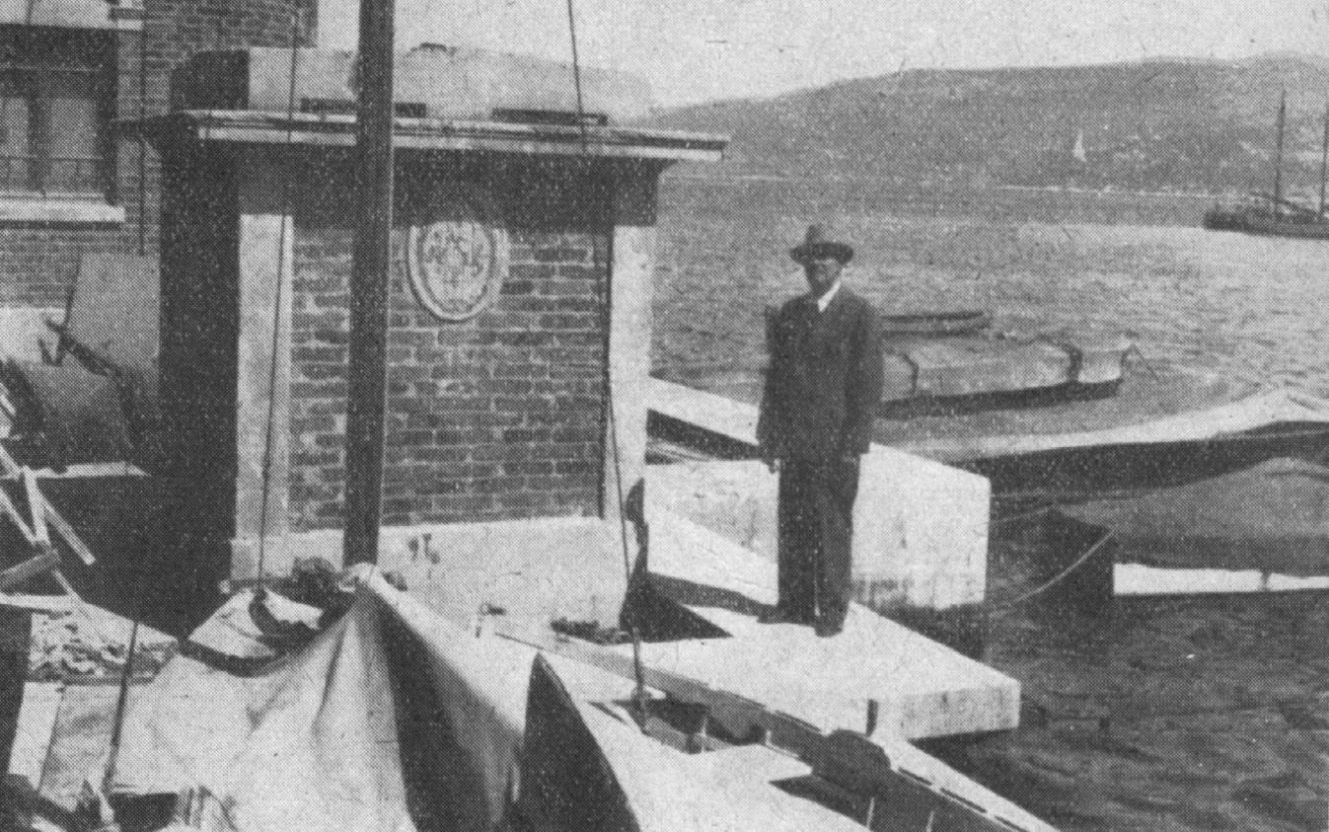
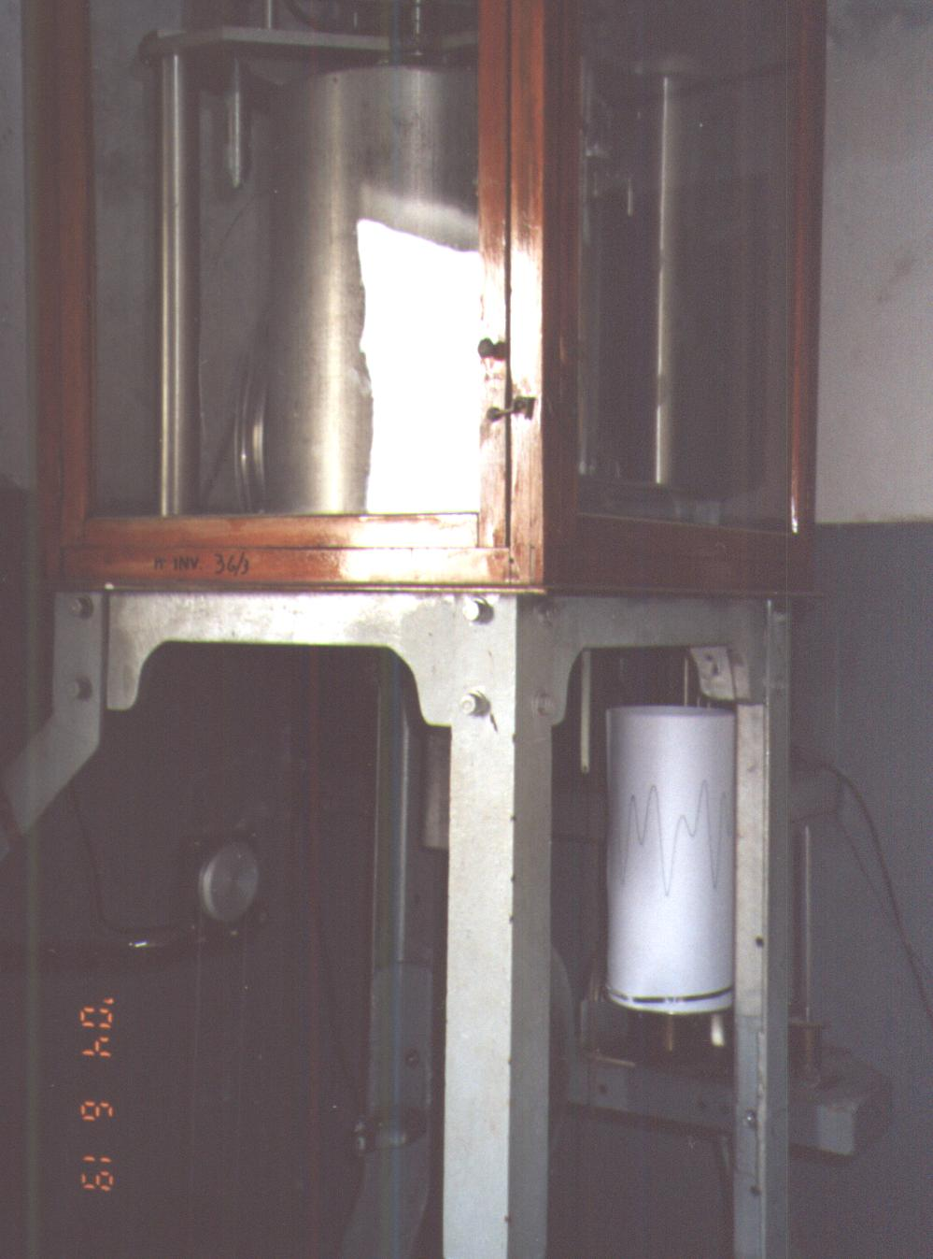
The Molo Sartorio in Trieste

Slide 49
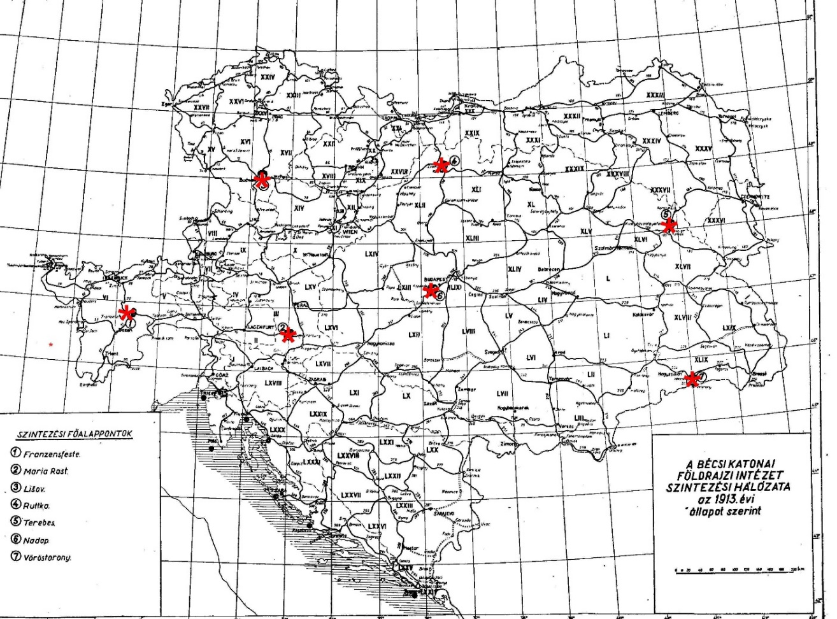
1873. ancient marks in Europe

Slide 50
Thank you for the attention!

