Slide 1
Moment of a force around a point P in the plane.
M = F*d [kNm]. It is positive if the force turns counter-clockwise around the point like the positive sens of rotation of the coordinate system. The moment expresses the rotational capacity of the force around the point.
d
F
P
To determine the sense of rotation proceed as follows. Put the tip of your pencil to the point P.
Place the pencil perpendicularly to the force. Then move the other end in the direction as the force points. The rotation of the pencil shows you the sense. In the example, it is
counter-clockwise, positive.
d
d
F
F
P
P

Slide 2
Computation of the moment of a force F around a point P. The moment of the force is equal to the sum of the moments of its components.
M^{(P)} = $±Fx∗dy±Fy∗dx$
Now $−Fx∗dy+Fy∗dx$
y
means that we give the sign by observation.
The $±$
Fy
F
-
dx: distance between P and Fy
dy: distance between P and Fx
Fx
dy
+
+
P
dx
x

Slide 3
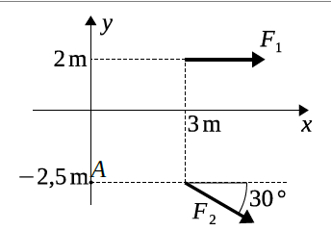
Example 1
Calculate the moment of forces F₁ and F₂ shown in
the figure about point A as well as about the origin.
F₁=12kN, F₂=9kN
Moments of the force F₁:
M₁^{(o)} =
- 12 * 2 =
- 24kNm
M₁^{(A)} =
- 12 * 4.5 =
- 54kNm
The force F₂ is skew so first we have to compute its components.
F_{2x} =
9*cos(30ᵒ) =
+7.794kN(→)
F_{2y} =
-9*sin(30ᵒ) =
-4.500kN(↓)
M₂^{(o)} =
+7,794*2,5
- 4.5*3 =
+5.985kNm(↶)
M₂^{(A)} =
+7.794 * 0
- 4.5*3 =
−13.50kNm(↷)
If the line of action of a force goes through a point then it does not have moment around it.

Slide 4
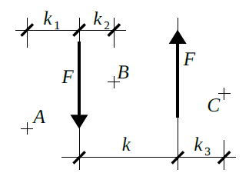
Parallel system of forces: the couple
A couple consists of two parellel forces of equal value but opposite direction. The force projection of these vectors is 0 but they have the same moment to any point of the plane.
The couple is considered as another dynamic object after the force which cannot be simplyfied more. As the force projection of the couple is 0 and its moment is the same to any point of the plane, there is a new symbol for the couple, its arc and a new name M.
M
It is positive if its sense of rotation is counter-clockwise.

Slide 5
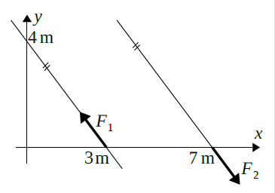
Resultant of parallel force systems in the plane
In the plane, on can write 2 equations for the equivalence of parallel force systems.
One force projection equation and one moment equation. So, if the forces act in the y direction:
({F_{i}}) ≡ ({Q_{j}}) → $\sum{F_{i,y}}$ = $\sum{Q_{j,y}}$, $\sum{{MO}_{i,F}}$ = $\sum{{MO}_{j,Q}}$
If one of the systems is a single dynamic object then we call it the resultant
2 triangles are similar if their angles are the same.
F1x=F1*lx/l=12*3/5=7.2 F1y= F1*ly/l = 12*4/5 =9.6
Example 4
Determine the other representaion of a couple given by the two forces.
F1=F2=12kN according to the figure
a) by summation of the moments of each force
about the origin,
b) by calculating the arm of the couple.
?
4/5*
4=3.2
l
The moment of a couple is the same to any point!!!
ly
A
lx
M = -12*3.2 =
-38.4kNm
similar triangles
Fy = ly/l *F
=4/5*12 = 9.6 kN
M=-9.6*4= -38.4kNm
ratio?
4/5
M = - 9.6*4 = -38.4 kNm

Slide 6
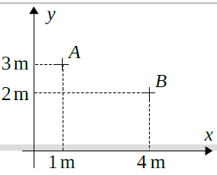
Example 5
Replace the moment M=27 kNm (↶) by a couple of vertical
forces passing through points A and B, respectively.
KEY: The moment of the 2 vertical forces should be 27kNm.
As the forces are vertical, the horizontal distance matters which we know. How much is it?
h = 3m
So the equation:
M =
F * h
F
h
27 =
F * 3
→ F = 9 kN
F
If the couple is vertical then the value of the forces is 9 kN.

Slide 7
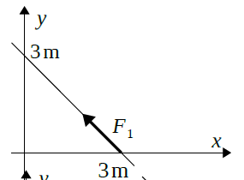
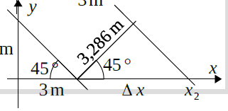
Example 6
Replace the torque M=23 kNm by a couple
involving a force F1=7kN as shown in the figure.
How much should be the force F₂ ?
7 kN
How much should be the distance between them?
The equation: M =
F * d
→ d = M/F = 23/7 =
3.286 m
F₂
How much is Δx ?
Equation: Δx * cos 45ᵒ = d →
Δx = d/cos45ᵒ
Δx = 3.286/cos45ᵒ = 4.647 m

Slide 8
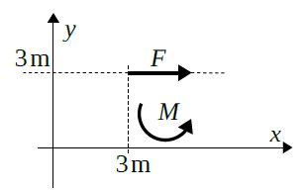
Example 7
Determine the resultant of the force F=13 kN
and torque M=14kNm given in the figure.
y_{R}
Theory:
‧
R = (F, M)
R = ΣFix,
R = 13 kN
The force projection od a couple is 0.
R * y_{R} = ΣMº_{i}
-13 * y_{R} =
- 13* 3 + 14
y_{R} = 1.923m

Slide 9
Parallel distributed system of forces
The concentrated force is an idealization. Bodies always contact each other on a surface. Those forces are called distributed system of forces. We characterize the distributed system of forces by their intensity vektor. We use the letters q, p, g for their names.
Distributed system of forces act along a line, on a surface or in a volume. Respectively, the unit of their intensity is kN/m, kN/m² and kN/m³.
The direction and magnitude of the intensity vector can vary from point to point but for simplicity we shall consider only parallel systems of distributed forces,
In the computations, we always replace the distributed system of forces by their resultant. The value of the resultant depending on the type of the system is the area or the volume of the distributed force diagram and the resultant is situated at the center of gravity of the diagram.

Slide 10
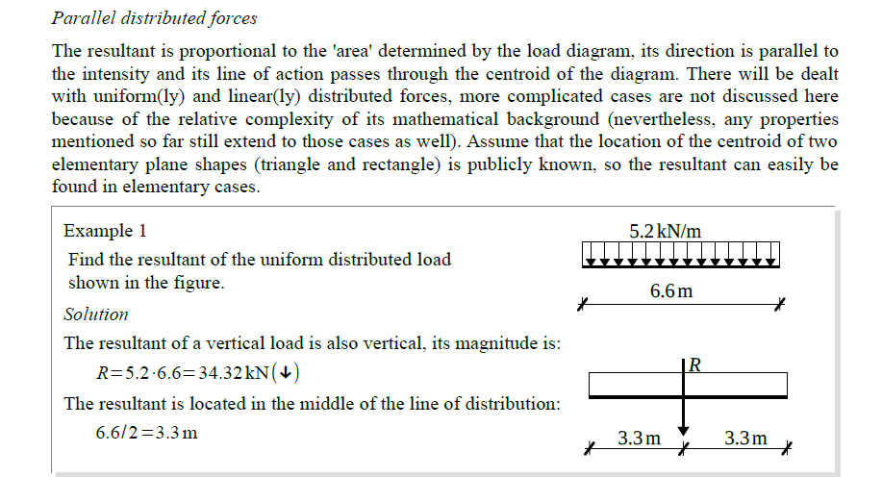
The value of the resultant is the area of the load diagram. The position of the resultant is the centroid of the load diagram.

Slide 11
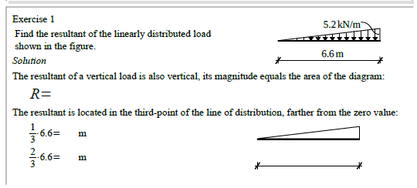
5.2*6.6/2 = 17.16 kN
2.2
4.4
R
l/3

Slide 12
R2
R1
2.1
5.4
O
1.6
2.4
({q}) ≡ (R1,R2)
R1 =5.4*4.8 = 25.92kN R2 = 2.1*4.8/2 =5.04 kN
x_{R}
R = R1 + R2 = 30.96 kN
R
Position of the resultant?
If two force systems are equivalent then their moment is the same to any point.
ΣM^{O} = - 30.96*x_{R} = -25.92*2.4 -5.04*1.6 → x_{R} = 2.270m
R2
R1
2nd solution: R1 = 5.4*4.8/2 = 12.96 kN
R2 = 7.5*4.8/2 = 18 → R = 30.96 kN
ΣM^{O} = -30.96*xR = -12.96*3.2 – 18*1.6 → x_{R} = 2.270m
7.5
5.4

Slide 13
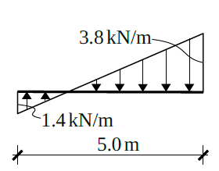
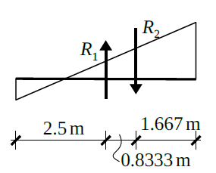
Distributed force system along a line
We decompose the system into a uniform and a triangular distribution.
Find the resultant of the distributed load
shown in the figure.
O
y
2/3*5
5/3
We compute the subresultants of the decompositions.
R1 =
-1.4*5 = -7.0 kN (↑)
R2 =
5.2*5/2 = 13.0 kN (↓)
x_{R}
R
ΣMi^{(o)}:
- 6 *x_{R} =
7*2.5 – 13 * (2.5+0.8333)
Check:
x_{R} =
4.305m
R1=-1.4*5/2= -3.5
R=9.5-3.5=6
Equivalence statement: R ≡ (R1,R2)
-1,4
x_{R} = 4.305m
Equivalence equations:
R2=3.8*5/2=9.5
ΣFiy: R = 13 – 7 = 6 kN (↓)
3.8
ΣMi^{(o)}:
- 6 *x_{R} =
3.5*1.667-9.5*3.333

